Slide 1
According to His Purpose
All things work together for good
Romans 8:28
Things work out because they were designed to work out
Ephesians 3:9-11
Ephesians 1:11
2 Timothy 1:9

Slide 2
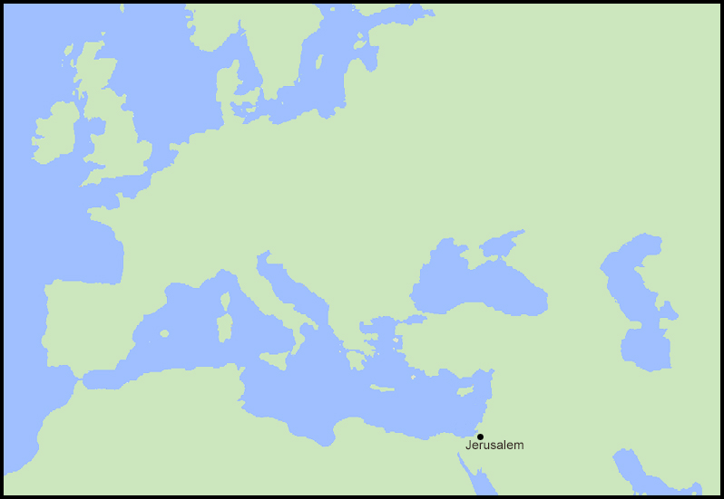
700 years before Christ was born, a prophet living in Judah spoke the words recorded in Isaiah 9:6-7:

Slide 3
Isaiah 9:6-7 ⁶ For unto us a child is born, unto us a son is given: and the government shall be upon his shoulder: and his name shall be called Wonderful, Counsellor, The mighty God, The everlasting Father, The Prince of Peace.
⁷ Of the increase of his government and peace there shall be no end, upon the throne of David, and upon his kingdom, to order it, and to establish it with judgment and with justice from henceforth even for ever. The zeal of the LORD of hosts will perform this.

Slide 4
On a distant peninsula at about the same time, the city of Rome was founded in 753 BC.

Slide 5
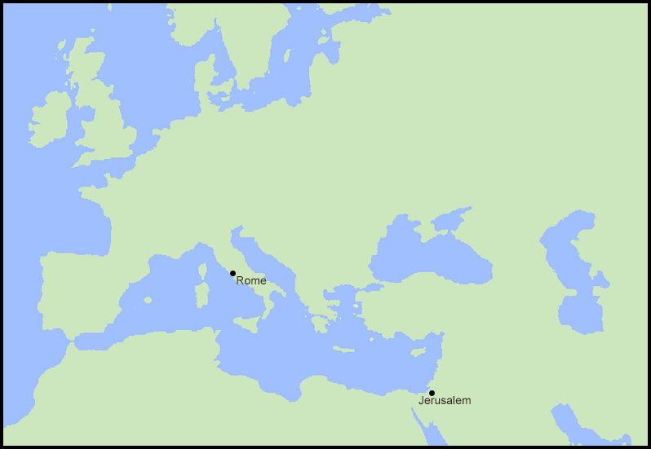
At about the same time on a distant peninsula, the city of Rome was founded in 753 BC.

Slide 6
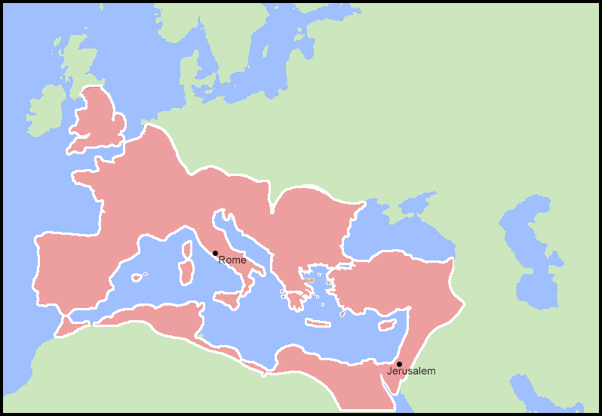
Just a short time before Christ was born, Rome had become an empire.

Slide 7
Luke 2:1
And it came to pass in those days, that there went out a decree from Caesar Augustus, that all the world should be taxed.

Slide 8
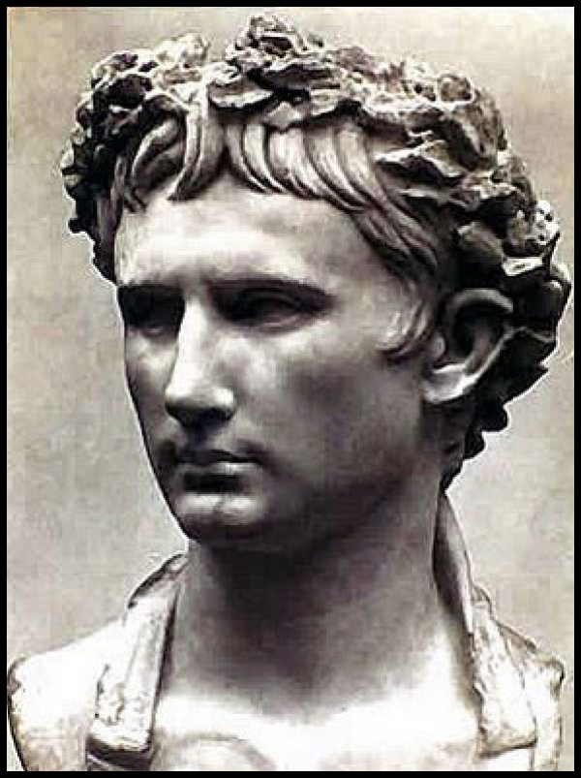
Caesar Augustus
Founder and first emperor of the Roman Empire
Ruled from 27 BC to his death in AD 14
Born Gaius Octavius
The grandnephew and adopted son of Julius Caesar

Slide 9
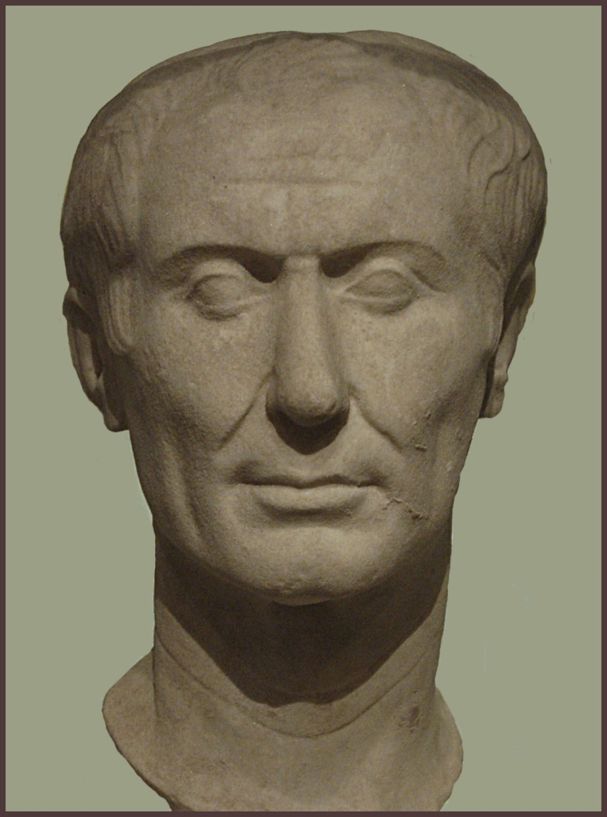
Julius Caesar
The only one of the famous Caesars actually born with that name
Legendary general and politician of the Roman Republic
From Caesar comes German “Kaiser” and Russian “Czar”
The seventh month was renamed in his honor

Slide 10
A VERY Short History of Rome
753 BC – the city of Rome is founded as a monarchy.
509 BC to 27 BC – Rome is governed as a Republic, lead by the Roman Senate.
In a republic, the exercise of sovereign power is lodged in representatives of the people, either by election or appointment.
In a democracy, the supreme power is lodged in the hands of the people collectively.
59 BC to 53 BC – Rome is ruled by the “First Triumvirate” – three Roman generals, Julius Caesar, Pompey the Great, and Marcus Licinius Crassus.
53 BC – Crassus killed in battle. Pompey and Caesar begin a civil war for power.
48 BC: Pompey assassinated in Egypt. Julius becomes a dictator with Mark Antony his second in command.
44 BC: Caesar assassinated by a group of senators led by Marcus Brutus. In his will he names his grandnephew Gaius Octavius as his heir and adopted son.
42 BC: Mark Antony avenges the murder of Julius Caesar when his armies defeat Brutus and Cassius at Philippi.

Slide 11
A VERY Short History of Rome
37 BC: Rome appoints Herod king of Judea.
Mark Anthony is sent to Egypt where he has an affair with Cleopatra, the queen and last ruling pharaoh of Egypt. Cleopatra had previously borne a son to Julius Caesar, named Caesarion, whom they felt was the rightful heir. Another civil war begins for the rule of Rome.
31 BC: Gaius Octavius defeats Mark Anthony in battle ending the civil wars.
30 BC: Marcus Antonius and Cleopatra commit suicide and Egypt is annexed to Rome.
Gaius Octavius is renamed Caesar Augustus and made the first emperor of Rome. “Caesar” is appropriated by all the Roman emperors as part of their title. “August” means grand, exalted, magnificent.

Slide 12
With the political world in such upheaval, it is no wonder that King Herod was so unnerved by the rumors of the birth of a new king.
Reading:
Matthew 2:1-12 – the wise men and King Herod
Matthew 2:13-15 – the angel’s warning to Joseph
Hosea 11:1 : When Israel was a child, then I loved him, and called my son out of Egypt.
The annexation of Egypt following the defeat of Anthony and Cleopatra made it possible for Joseph and Mary to have safe passage into Egypt. This is where Jesus spent his early years until the death of Herod, which historians say occurred in the spring of 4 BC.

Slide 13
Things work out because they were designed to work out.
Ephesians 1:11
In whom also we have obtained an inheritance, being predestinated according to the purpose of him who worketh all things after the counsel of his own will:
Psalm 31:15
My times are in thy hand: deliver me from the hand of mine enemies, and from them that persecute me.

