Slide 1
O Little Town of Bethlehem
In Geography
In History
In Prophecy
In the birth of Jesus Christ

Slide 2
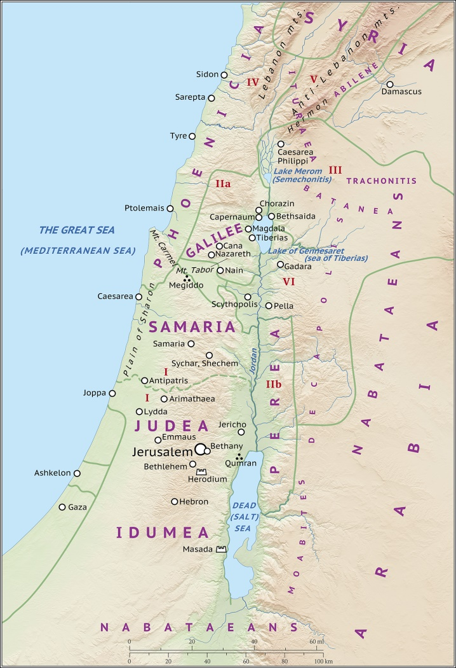
In Geography
Bethlehem is about 5 miles south of Jerusalem

Slide 3
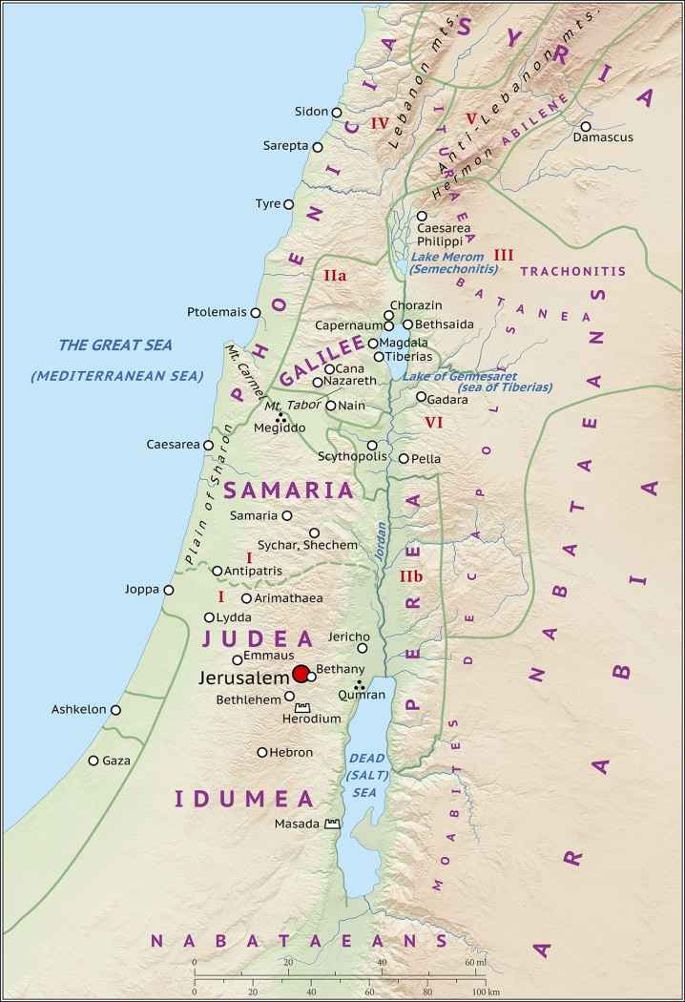
In Geography
Bethlehem is about 5 miles south of Jerusalem

Slide 4
In Geography
Bethlehem is about 5 miles south of Jerusalem

Slide 5
Burying place of Rachel, the wife of Jacob and younger sister of Leah
In Geography
In History
Notes:
Ephrath Eff’-rath

Slide 6
Burying place of Rachel, the wife of Jacob and younger sister of Leah
Genesis 35:19-20 ¹⁹ And Rachel died, and was buried in the way to Ephrath, which is Bethlehem.
²⁰ And Jacob set a pillar upon her grave: that is the pillar of Rachel's grave unto this day.
In Geography
In History
Notes:
Ephrath Eff’-rath

Slide 7
Burying place of Rachel, the wife of Jacob and younger sister of Leah
Hometown of Boaz, the husband of Ruth, and great-grandfather of King David
Ruth 4:11 And all the people that were in the gate, and the elders, said, We are witnesses. The LORD make the woman that is come into thine house like Rachel and like Leah, which two did build the house of Israel: and do thou worthily in Ephratah, and be famous in Bethlehem:
In Geography
In History
Notes:
Ephrathah Eff’-rath-a

Slide 8
Burying place of Rachel, the wife of Jacob and younger sister of Leah
Hometown of Boaz, the husband of Ruth, and great-grandfather of King David
Ruth 4:16-17
¹⁶ And Naomi took the child, and laid it in her bosom, and became nurse unto it. ¹⁷ And the women her neighbours gave it a name, saying, There is a son born to Naomi; and they called his name Obed: he is the father of Jesse, the father of David.
In Geography
In History
Notes:
Ephrathah Eff’-rath-a

Slide 9
Burying place of Rachel, the wife of Jacob and younger sister of Leah
Hometown of Boaz, the husband of Ruth, and great-grandfather of King David
Birthplace of David, and where he was anointed by Samuel
John 7:42
Hath not the scripture said, That Christ cometh of the seed of David, and out of the town of Bethlehem, where David was?
In Geography
In History

Slide 10
Burying place of Rachel, the wife of Jacob and younger sister of Leah
Hometown of Boaz, the husband of Ruth, and great-grandfather of King David
Birthplace of David, and where he was anointed by Samuel
1 Samuel 16:1 And the LORD said unto Samuel, How long wilt thou mourn for Saul, seeing I have rejected him from reigning over Israel? fill thine horn with oil, and go, I will send thee to Jesse the Bethlehemite: for I have provided me a king among his sons.
In Geography
In History

Slide 11
Micah 5:2
But thou, Bethlehem Ephratah, though thou be little among the thousands of Judah, yet out of thee shall he come forth unto me that is to be ruler in Israel; whose goings forth have been from of old, from everlasting.
In Geography
In History
In Prophecy
Notes:
Ephratah Eff’-ratt-a

Slide 12
In Geography
In History
In Prophecy
In the birth of Jesus Christ

Slide 13
Matthew 2:1-6
¹ Now when Jesus was born in Bethlehem of Judaea in the days of Herod the king, behold, there came wise men from the east to Jerusalem,
² Saying, Where is he that is born King of the Jews? for we have seen his star in the east, and are come to worship him.
³ When Herod the king had heard these things, he was troubled, and all Jerusalem with him.
⁴ And when he had gathered all the chief priests and scribes of the people together, he demanded of them where Christ should be born.
⁵ And they said unto him, In Bethlehem of Judaea: for thus it is written by the prophet,
⁶ And thou Bethlehem, in the land of Juda, art not the least among the princes of Juda: for out of thee shall come a Governor, that shall rule my people Israel.

Slide 14
2 Samuel 5:7 Nevertheless David took the strong hold of Zion: the same is the city of David.
Matthew 2:1-6
The city of David (but not to be confused with Jerusalem)
In Geography
In History
In Prophecy
In the birth of Jesus Christ

Slide 15
Luke 2:4
And Joseph also went up from Galilee, out of the city of Nazareth, into Judaea, unto the city of David, which is called Bethlehem; (because he was of the house and lineage of David:)
Matthew 2:1-6
The city of David
In Geography
In History
In Prophecy
In the birth of Jesus Christ

Slide 16
Luke 2:10-11
¹⁰ And the angel said unto them, Fear not: for, behold, I bring you good tidings of great joy, which shall be to all people.
¹¹ For unto you is born this day in the city of David a Saviour, which is Christ the Lord.
Matthew 2:1-6
The city of David
In Geography
In History
In Prophecy
In the birth of Jesus Christ

Slide 17
O Little Town of Bethlehem
In Geography
In History
In Prophecy
In the birth of Jesus Christ

