Slide 1
Father’s Day 2016

Slide 2
“Don’t be afraid to fear the Lord”

Slide 3
What comes to your mind when you think of a policeman?

Slide 4
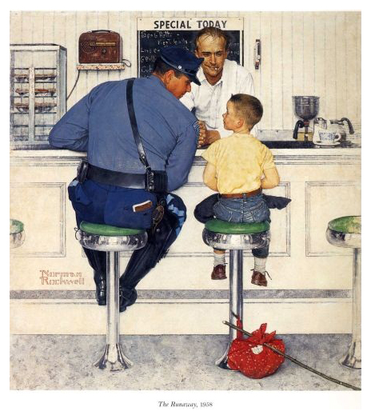
The kind-hearted guardian of the neighborhood?

Slide 5
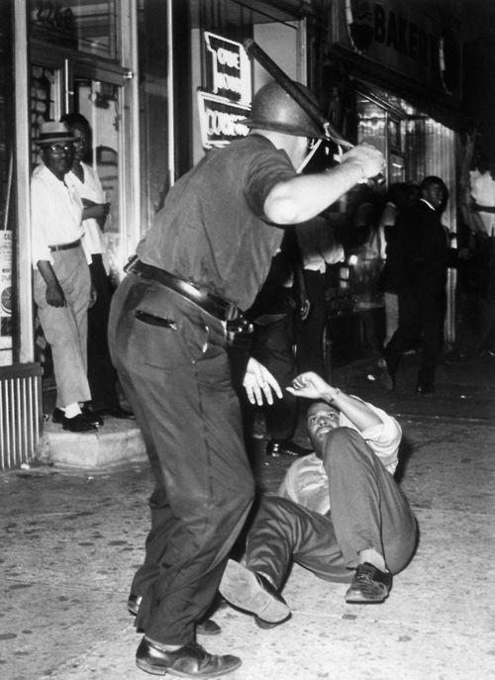
Or something far more brutal and threatening?

Slide 6
What about when you hear the word ‘father’?

Slide 7
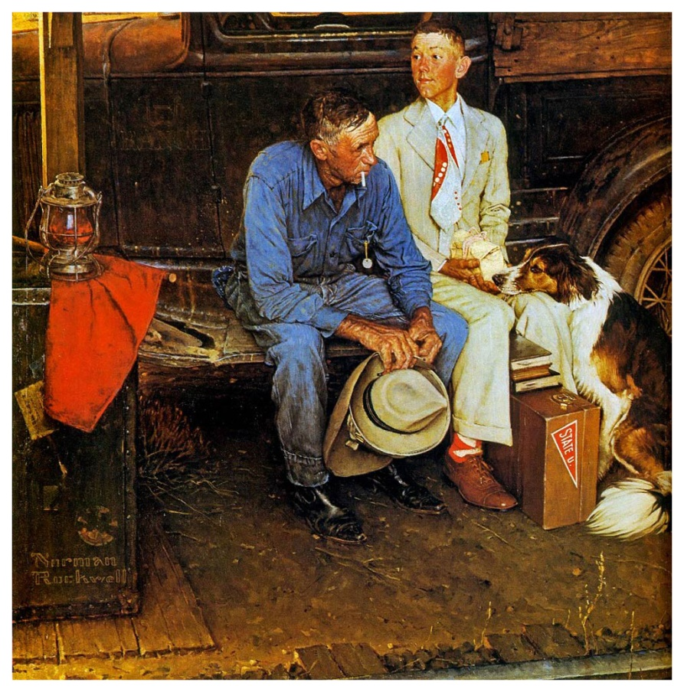
A man who should be in a Norman Rockwell painting …

Slide 8
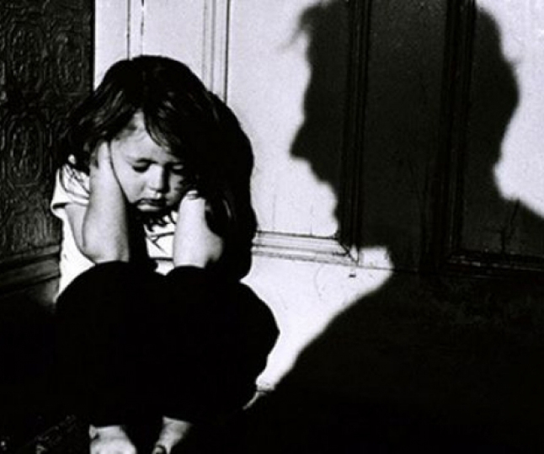
or in prison?

Slide 9
When you think about “the fear of the Lord,” do you picture …

Slide 11
Don’t be afraid to fear the Lord!
God is not an abusive father!

Slide 12
How important is the fear of the Lord?
It is the beginning of wisdom and knowledge.
Proverbs 9:10: The fear of the LORD is the beginning of wisdom: and the knowledge of the holy is understanding.
Proverbs 1:7: The fear of the LORD is the beginning of knowledge: but fools despise wisdom and instruction.
Proverbs 1:29: For that they hated knowledge, and did not choose the fear of the LORD:

Slide 13
How important is the fear of the Lord?
It is the beginning of wisdom and knowledge.
It is a wise man’s treasure.
Isaiah 33:6: And wisdom and knowledge shall be the stability of thy times, and strength of salvation: the fear of the LORD is his treasure.

Slide 14
How important is the fear of the Lord?
It is the beginning of wisdom and knowledge.
It is a wise man’s treasure.
It is the duty of every believer.
Ecclesiastes 12:13: Let us hear the conclusion of the whole matter: Fear God, and keep his commandments: for this is the whole duty of man.

Slide 15
How important is the fear of the Lord?
It is the beginning of wisdom and knowledge.
It is a wise man’s treasure.
It is the duty of every believer.
Ephesians 5:21: Submitting yourselves one to another in the fear of God.

Slide 16
How important is the fear of the Lord?
It is the beginning of wisdom and knowledge.
It is a wise man’s treasure.
It is the duty of every believer.
It is more than simple reverence.
Hebrews 12:28: Wherefore we receiving a kingdom which cannot be moved, let us have grace, whereby we may serve God acceptably with reverence and godly fear:

Slide 17
How important is the fear of the Lord?
It is the beginning of wisdom and knowledge.
It is a wise man’s treasure.
It is the duty of every believer.
It is more than simple reverence.
Hebrews 12:28: Wherefore we receiving a kingdom which cannot be moved, let us have grace, whereby we may serve God acceptably with reverence and godly fear:

Slide 18
How important is the fear of the Lord?
It is the beginning of wisdom and knowledge.
It is a wise man’s treasure.
It is the duty of every believer.
It is more than simple reverence.
Even Jesus walked in the fear of the Lord!
Hebrews 5:7-8: Who in the days of his flesh, when he had offered up prayers and supplications with strong crying and tears unto him that was able to save him from death, and was heard in that he feared,
8: Though he were a Son, yet learned he obedience by the things which he suffered;

Slide 19
Psalm 118:6: The LORD is on my side; I will not fear: what can man do unto me?

Slide 20
Jeremiah 5:22-25: Fear ye not me? saith the LORD: will ye not tremble at my presence, which have placed the sand for the bound of the sea by a perpetual decree, that it cannot pass it: and though the waves thereof toss themselves, yet can they not prevail; though they roar, yet can they not pass over it?
23: But this people hath a revolting and a rebellious heart; they are revolted and gone.
24: Neither say they in their heart, Let us now fear the LORD our God, that giveth rain, both the former and the latter, in his season: he reserveth unto us the appointed weeks of the harvest.
25: Your iniquities have turned away these things, and your sins have withholden good things from you.

Slide 21
Luke 1:30: And the angel said unto her, Fear not, Mary: for thou hast found favour with God.
1 John 4:18: There is no fear in love; but perfect love casteth out fear: because fear hath torment. He that feareth is not made perfect in love.
Acts 9:31: Then had the churches rest throughout all Judaea and Galilee and Samaria, and were edified; and walking in the fear of the Lord, and in the comfort of the Holy Ghost, were multiplied.

Slide 22
2 Timothy 1:7: For God hath not given us the spirit of fear; but of power, and of love, and of a sound mind.

Slide 23
Webster's 1828 Dictionary
1. A painful emotion or passion excited by an expectation of evil, or the apprehension of impending danger.

Slide 24
Webster's 1828 Dictionary
1. A painful emotion or passion excited by an expectation of evil, or the apprehension of impending danger.
2. In Scripture, a passion that is:
a) Filial: of or due from a son or daughter
…a holy awe or reverence of God and his laws, which springs from a just view and real love of the divine character, leading the subjects of it to hate and shun every thing that can offend such a holy being, and inclining them to aim at perfect obedience.
b) Slavish: relating to or characteristic of a slave, typically by behaving in a servile or submissive way
… the effect or consequence of guilt; it is the painful apprehension of merited punishment.

Slide 25
Returning to Hebrews chapter 5:
Hebrews 5:7: Who in the days of his flesh, when he had offered up prayers and supplications with strong crying and tears unto him that was able to save him from death, and was heard in that he feared,
His prayer is recorded in Mark:
Mark 14:36: And he said, Abba, Father, all things are possible unto thee; take away this cup from me: nevertheless not what I will, but what thou wilt.

Slide 26
Returning to Hebrews 5:
Hebrews 5:7: Who in the days of his flesh, when he had offered up prayers and supplications with strong crying and tears unto him that was able to save him from death, and was heard in that he feared,
This prayer is recorded in Mark:
Mark 14:36: And he said, Abba, Father, all things are possible unto thee; take away this cup from me: nevertheless not what I will, but what thou wilt.
“Abba, Father” occurs only three times in the Bible – here in Mark, and in Romans and Galatians.

Slide 27
Romans 8:14-17 :
14: For as many as are led by the Spirit of God, they are the sons of God. 15: For ye have not received the spirit of bondage again to fear; but ye have received the Spirit of adoption, whereby we cry, Abba, Father.
16: The Spirit itself beareth witness with our spirit, that we are the children of God:
17: And if children, then heirs; heirs of God, and joint-heirs with Christ; if so be that we suffer with him, that we may be also glorified together.

Slide 28
Galatians 4:6-7:
6: And because ye are sons, God hath sent forth the Spirit of his Son into your hearts, crying, Abba, Father.
7: Wherefore thou art no more a servant, but a son; and if a son, then an heir of God through Christ.

Slide 29
The fear of the Lord is NOT the fear that a slave has for his master, or an abused child has for a vicious parent.
It is a healthy passion that a cherished child has toward someone he/she loves, admires, respects, and does not want to disappoint.
Psalm 103:13:
Like as a father pitieth his children, so the LORD pitieth them that fear him.

Slide 30
One final point:
Does Abba Really Mean “Daddy”?
Why is this is important?
For the sake of biblical accuracy.
For the way it shapes our relationship with God.

Slide 31
From “Fact Checker - Does Abba Mean Daddy?”
“This origin of this understanding is generally traced to the notable German Lutheran New Testament scholar Joachim Jeremias who in his 1971 text New Testament Theology explained that abba was “the chatter of a small child…, a children's word, used in everyday talk.”
While Jeremias did not use the word “daddy” or “papa” in relation to abba, the implication was strong and others came along to make that connection.
In the Aramaic language of the time of Jesus, there was absolutely no other word [than Abba] available if Jesus wished to speak of or address God as father.”

Slide 32
From Lighthouse Ministries International :
“To call God ‘Abba, Father’ is to speak to him with reverence as well as confidence. …The Oxford linguist James Barr wrote an article for the Journal of Theological Studies called “Abba isn’t ‘Daddy’.” What Barr discovered was that abba was not merely a word used by young children. It was also the word that Jewish children used for their parents after they were fully grown. Abba was a mature, yet affectionate way for adults to speak to their fathers.”
The Aramaic word abba appears three times in the New Testament (Mark 14:36; Rom. 8:15; Gal. 4:6). In each case it is followed immediately by the Greek word pater. Pater is not the Greek word for ‘Daddy.’ The Greek language has a word for ‘Daddy’ – the word pappas – but that is not the word the New Testament uses to translate abba. Instead, in order to make sure that our intimacy with God does not become an excuse for immaturity, it says, ‘abba, pater.”

Slide 33
(continued):
“The best way to translate abba is “Dear Father,” or even “Dearest Father.” That phrase captures both the warm confidence and the deep reverence that we have for our Father in heaven. It expresses our intimacy with God, while preserving his dignity. When we pray, therefore, we are to say, ‘Our dear Father in heaven.’”

Slide 34
From “The Believer’s Bible Commentary” by William McDonald:
The Spirit creates an awareness of sonship, causing the saint to address God as Father. “Abba, Father” is a familiar form of address, combining the Aramaic and Greek words for “father.” No slave could address the head of a family in this fashion; it was reserved for members of the family, and expresses love and confidence.

Slide 35
In Swahili (which borrows from Arabic)
Baba – father, respected elder
Baba wa mbinguni - heavenly father
Baba yetu - Our Father (the Lord's Prayer)

Slide 36
Don’t be afraid to fear the Lord

