Slide 1
Synchronizing the Nativity Stories of Matthew and Luke

Slide 2
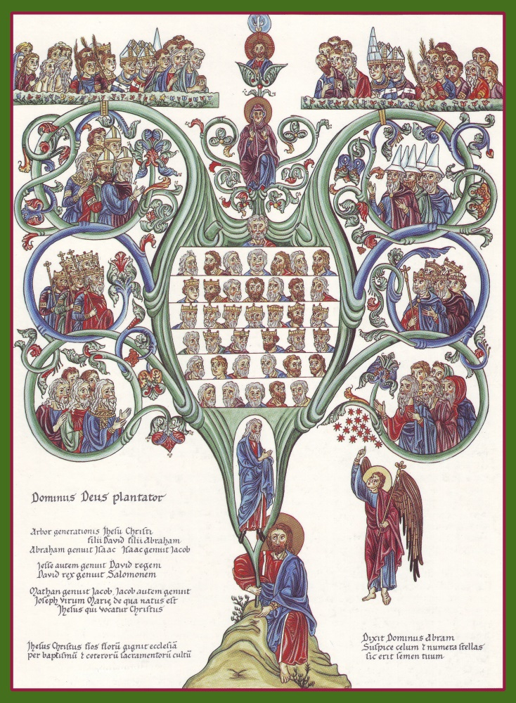
Matt 1:1-17
The generation of Jesus Christ, Abraham to Joseph.

Slide 3
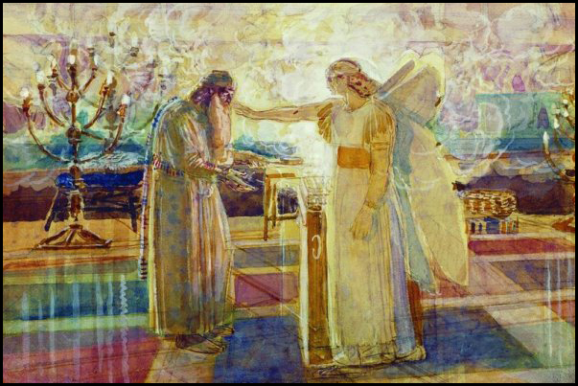
Luke 1:1-25 Gabriel appears to Zacharias at the Temple in Jerusalem;
Zacharias returns to his home which was likely in Hebron.
Joshua 21:13 Thus they gave to the children of Aaron the priest Hebron with her suburbs …

Slide 4
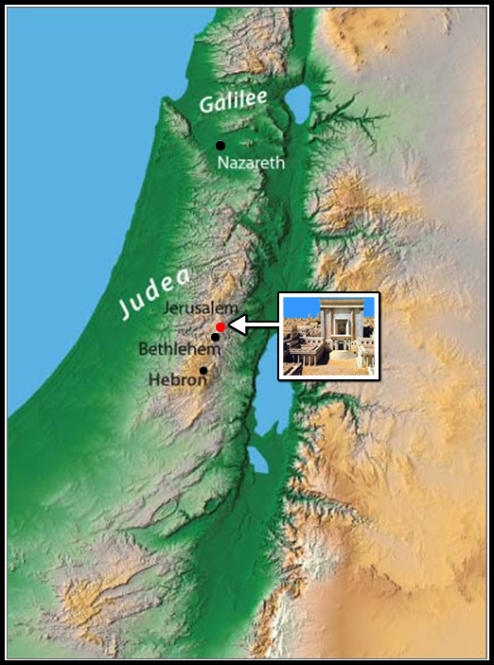
From Jerusalem to Hebron
is about 18 miles.

Slide 5
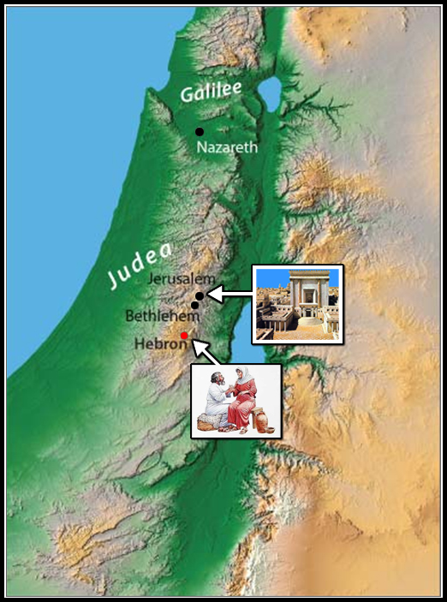
From Jerusalem to Hebron
is about 18 miles.

Slide 6
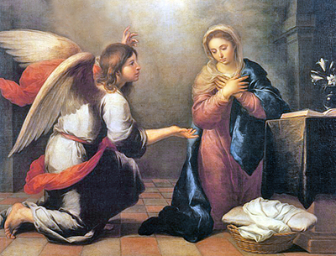
Luke 1:26-38 Gabriel appears to Mary in Nazareth of Galilee.
Matt 1:18 … she was found with child of the Holy Ghost.

Slide 7
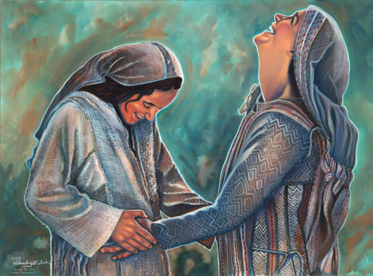
Luke 1:39-56 Mary visits Elizabeth

Slide 8
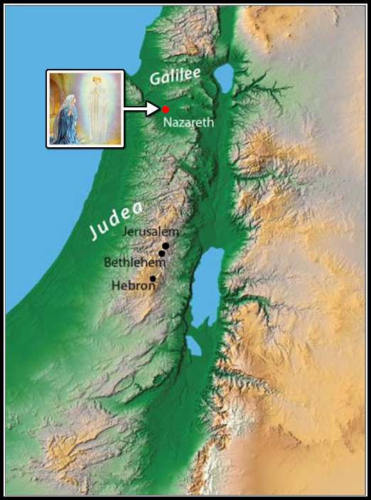
From Nazareth to Hebron
is about 80 miles.

Slide 9
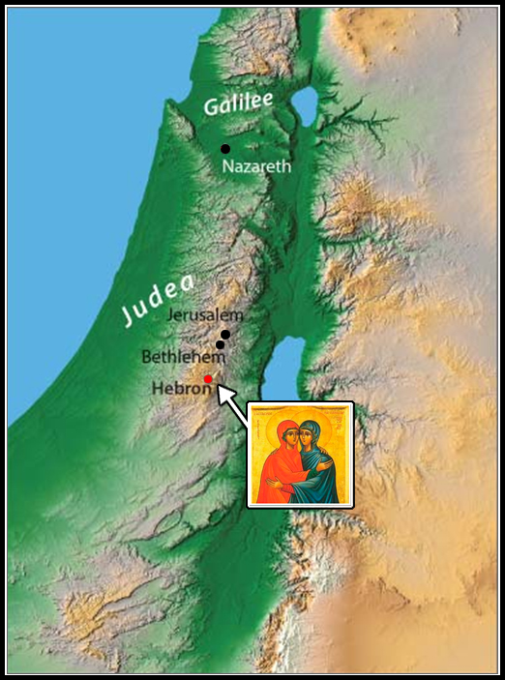
From Nazareth to Hebron
is about 80 miles.

Slide 10
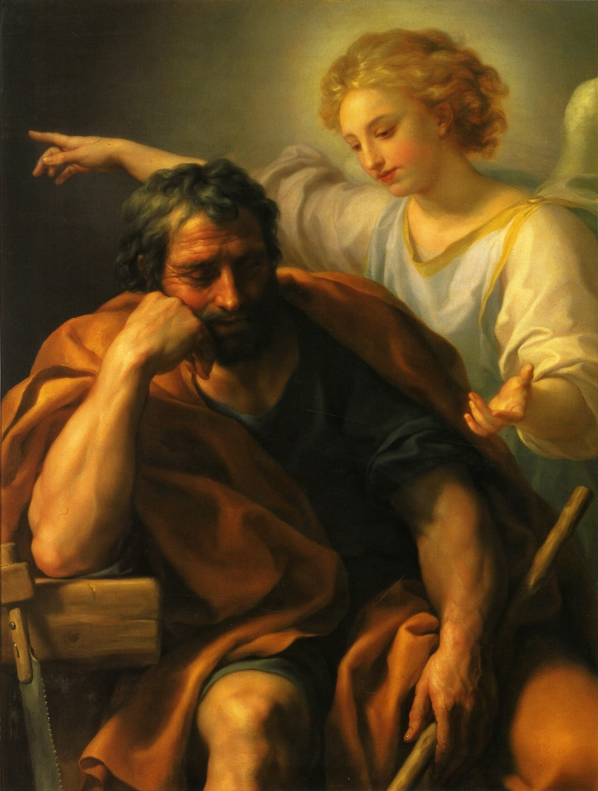
Matt 1:18-25 In Nazareth, Gabriel reassures Joseph in a dream.

Slide 11
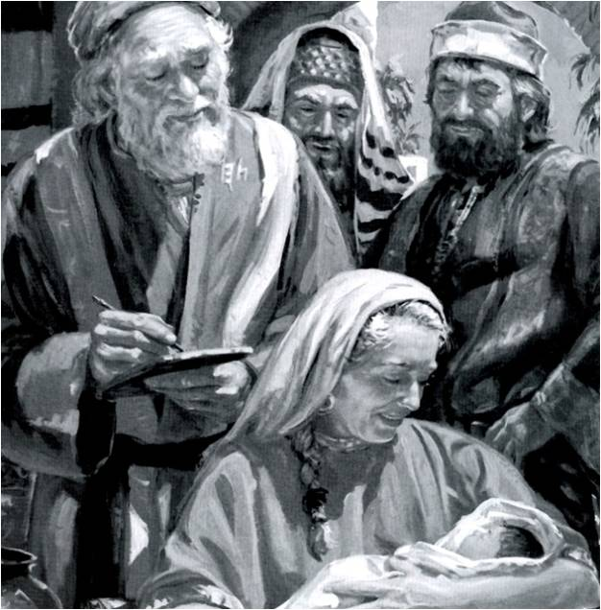
Luke 1:57-79
In Hebron, the birth, circumcision, and official naming of John

Slide 12
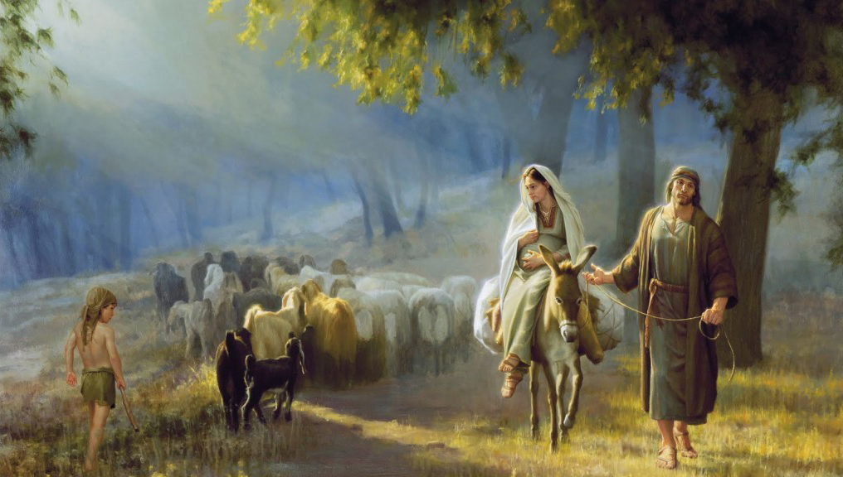
Luke 2:1-5 Joseph and Mary journey from Nazareth to Bethlehem for the Roman taxation.

Slide 13
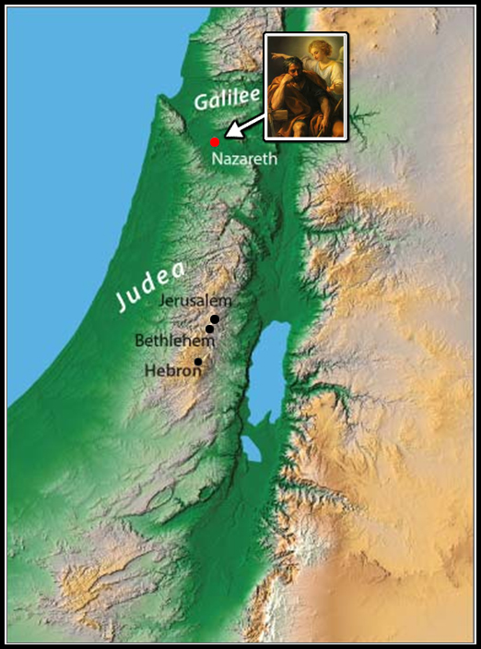
From Nazareth to Bethlehem is about 70 miles.

Slide 14
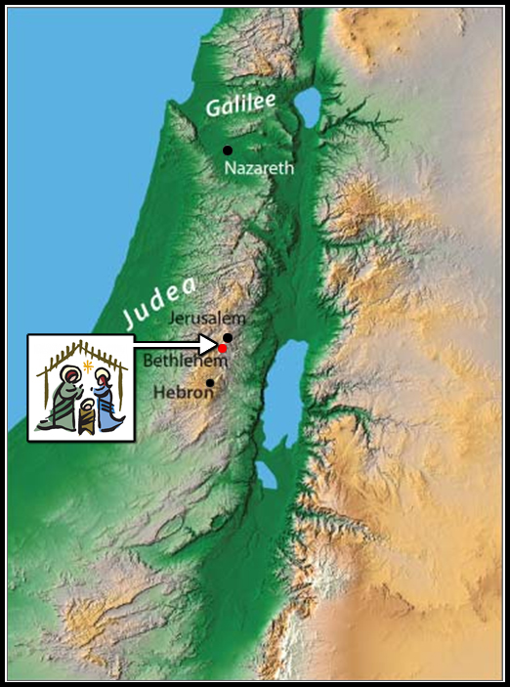
From Nazareth to Bethlehem is about 70 miles.

Slide 15
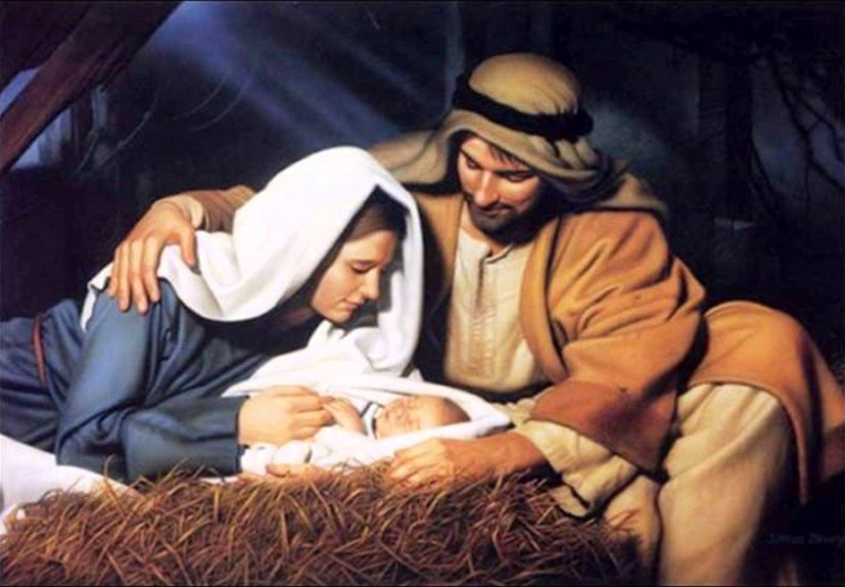
Matt 2:1, Luke 2:6-7 The birth of Christ

Slide 16
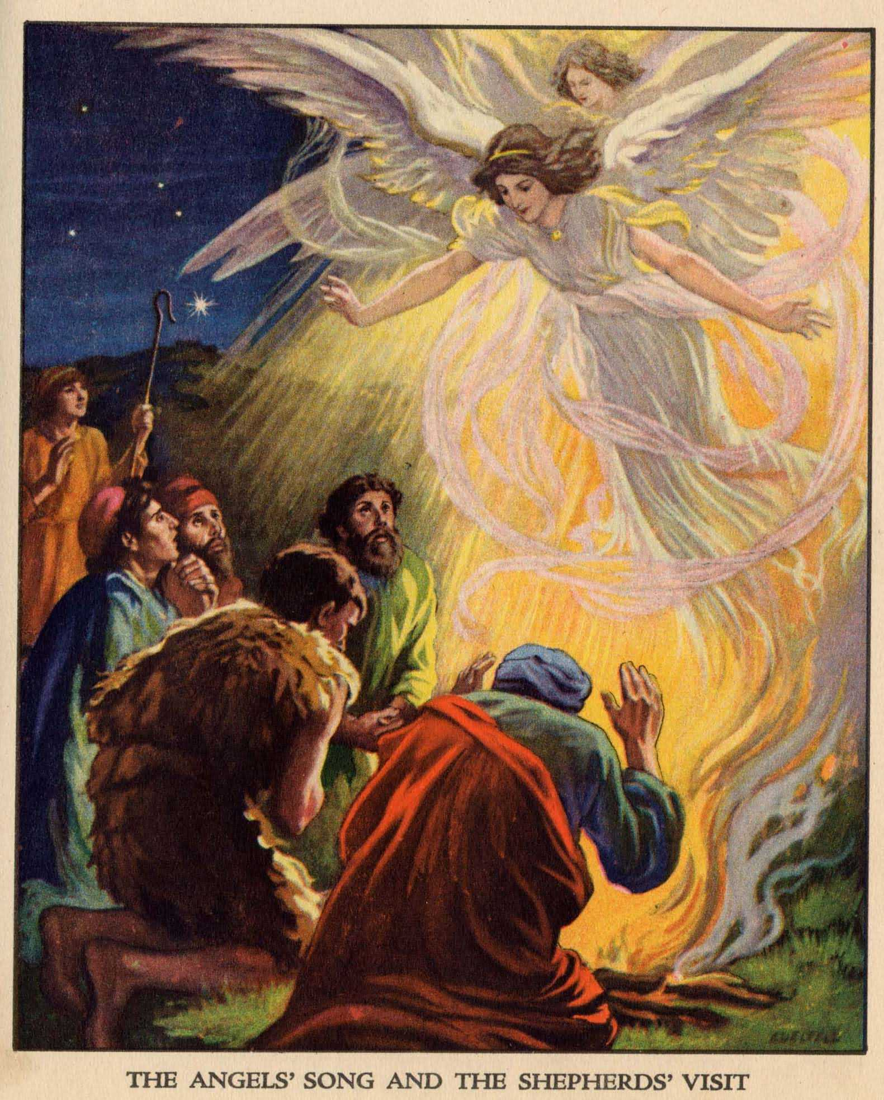
Luke 2:8-20 The angels and the shepherds

Slide 17
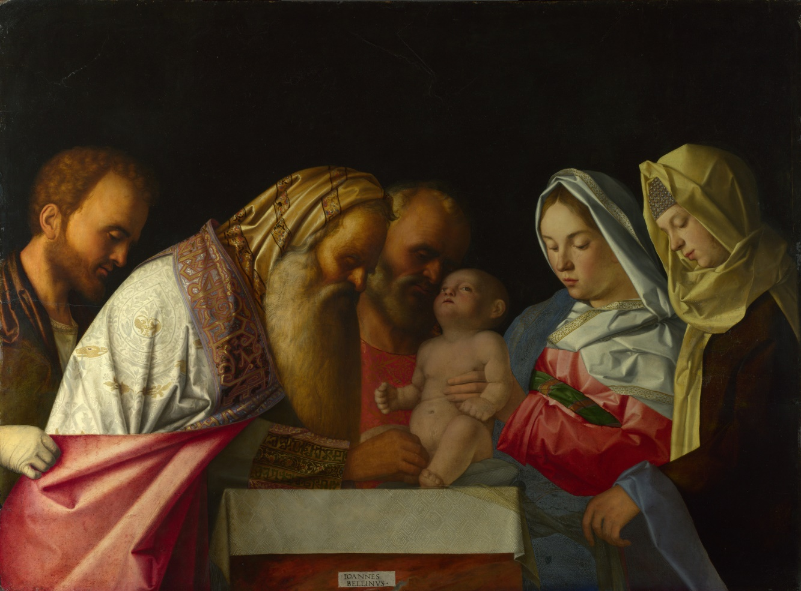
Luke 2:21
The circumcision and official naming of Jesus

Slide 18
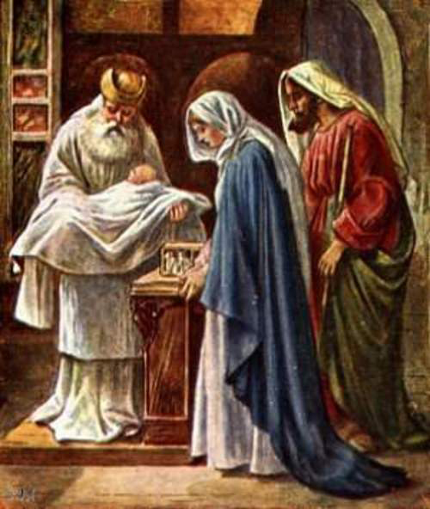
Luke 2:22-24
The presentation in the temple at Jerusalem

Slide 19
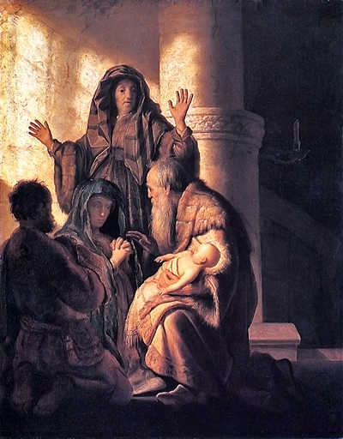
Luke 2:25-38 The prophecies of Simeon and Anna

Slide 20
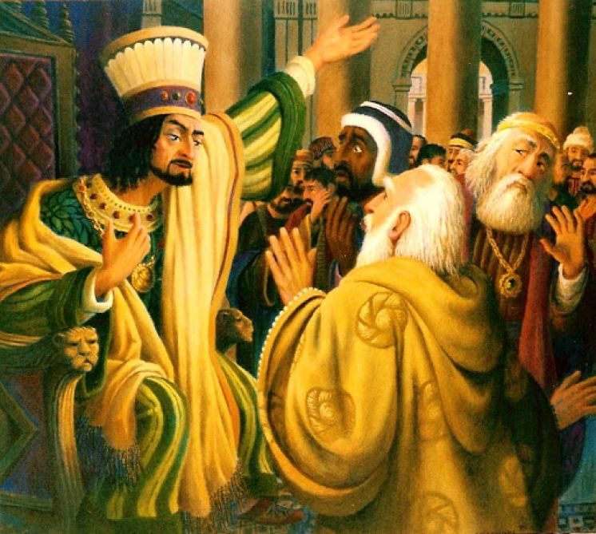
Matt 2:1-9 King Herod consults with the wise men from the east.

Slide 21
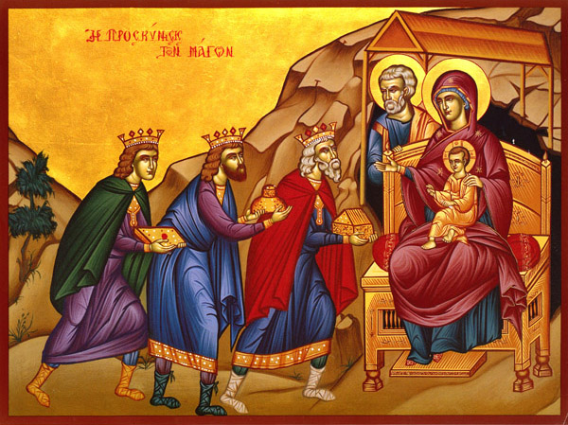
Matt 2:10-12
The wise men come to honor Jesus in Bethlehem.

Slide 22
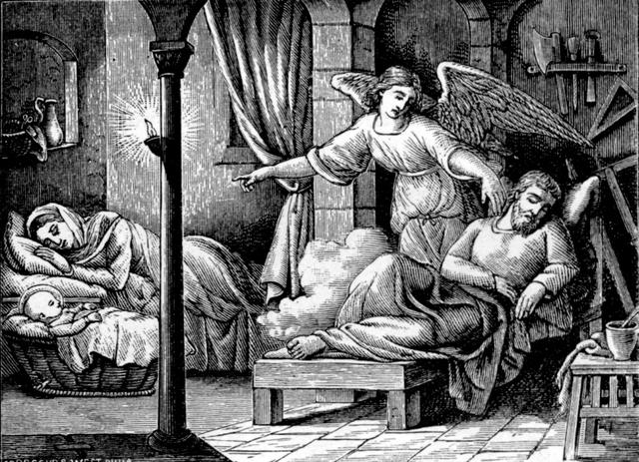
Matt 2:13-15
The angel sends the holy family to Egypt.

Slide 23
From Bethlehem to the border of Egypt is about 200 miles.

Slide 24
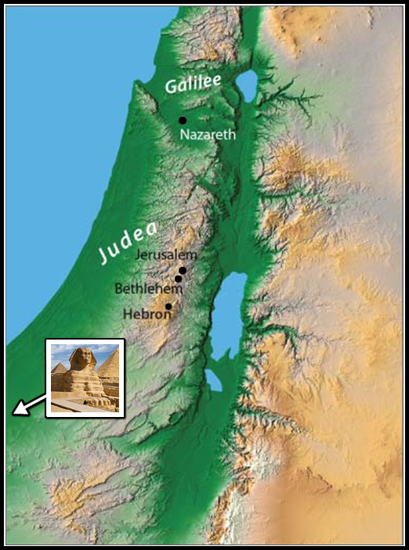
From Bethlehem to the border of Egypt is about 200 miles.

Slide 25
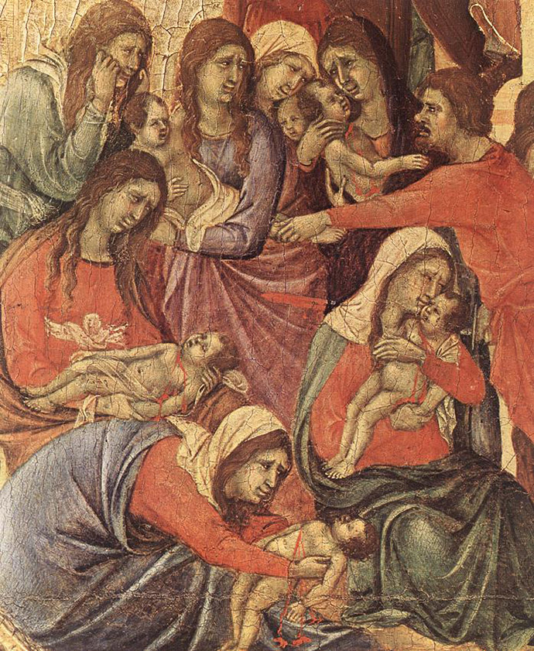
Matt 2:16-18
In Bethlehem, the massacre of the innocents

Slide 26
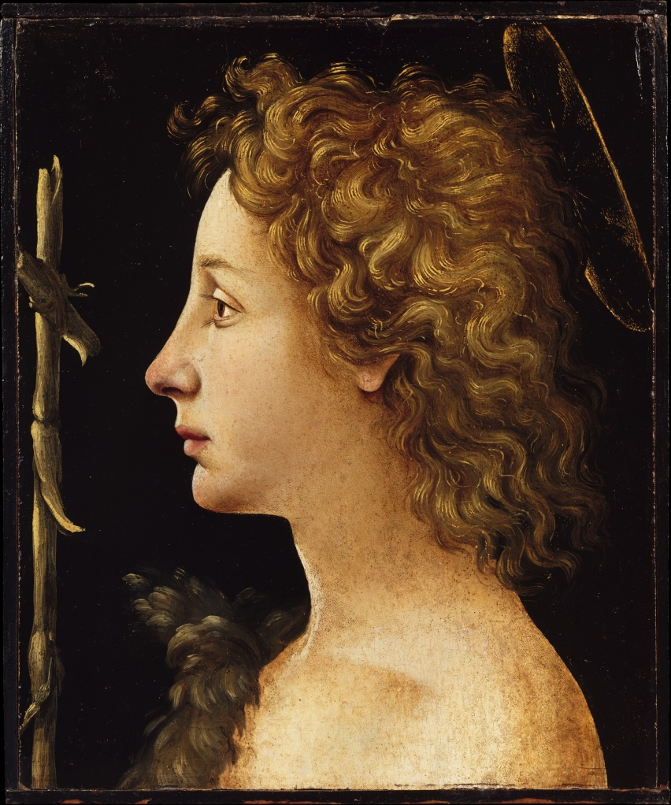
Luke 1:80
John the Baptist comes of age.

Slide 27
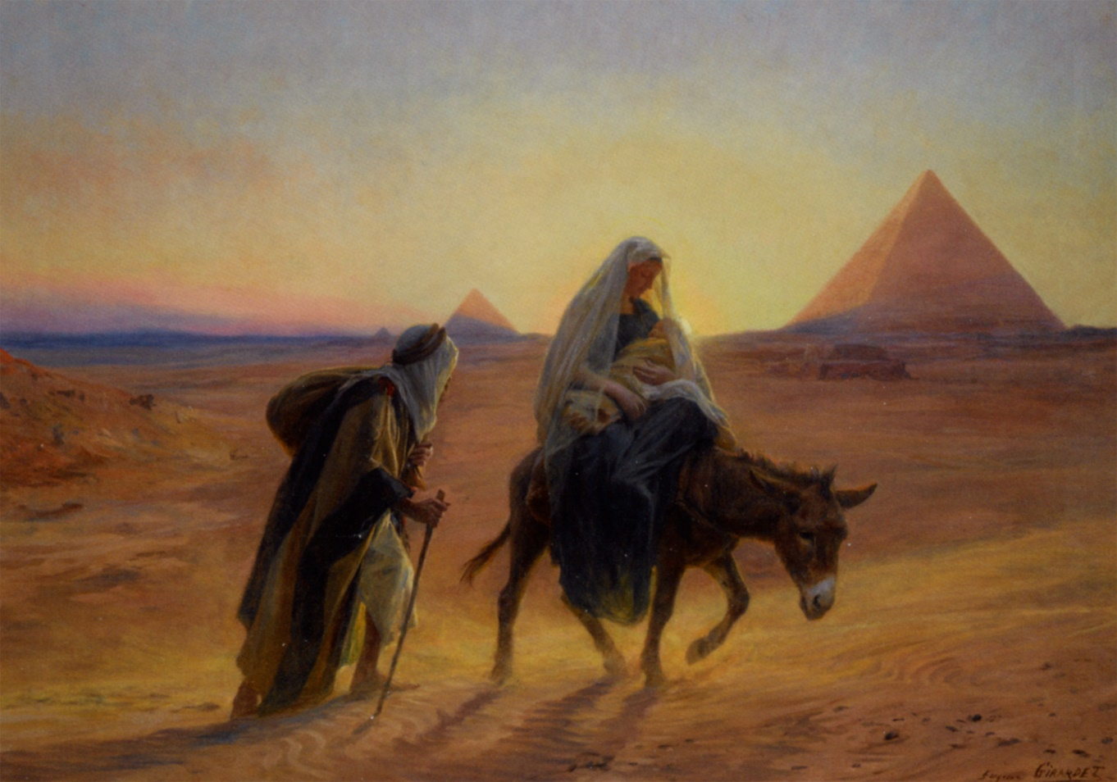
Matt 2:19-20
After the death of Herod, the family returns to Israel.

Slide 28
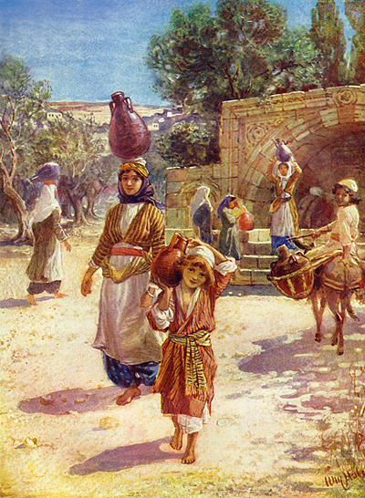
Matt 2:21-23, Luke 2:39-40
The family returns to Nazareth in Galilee.

Slide 29
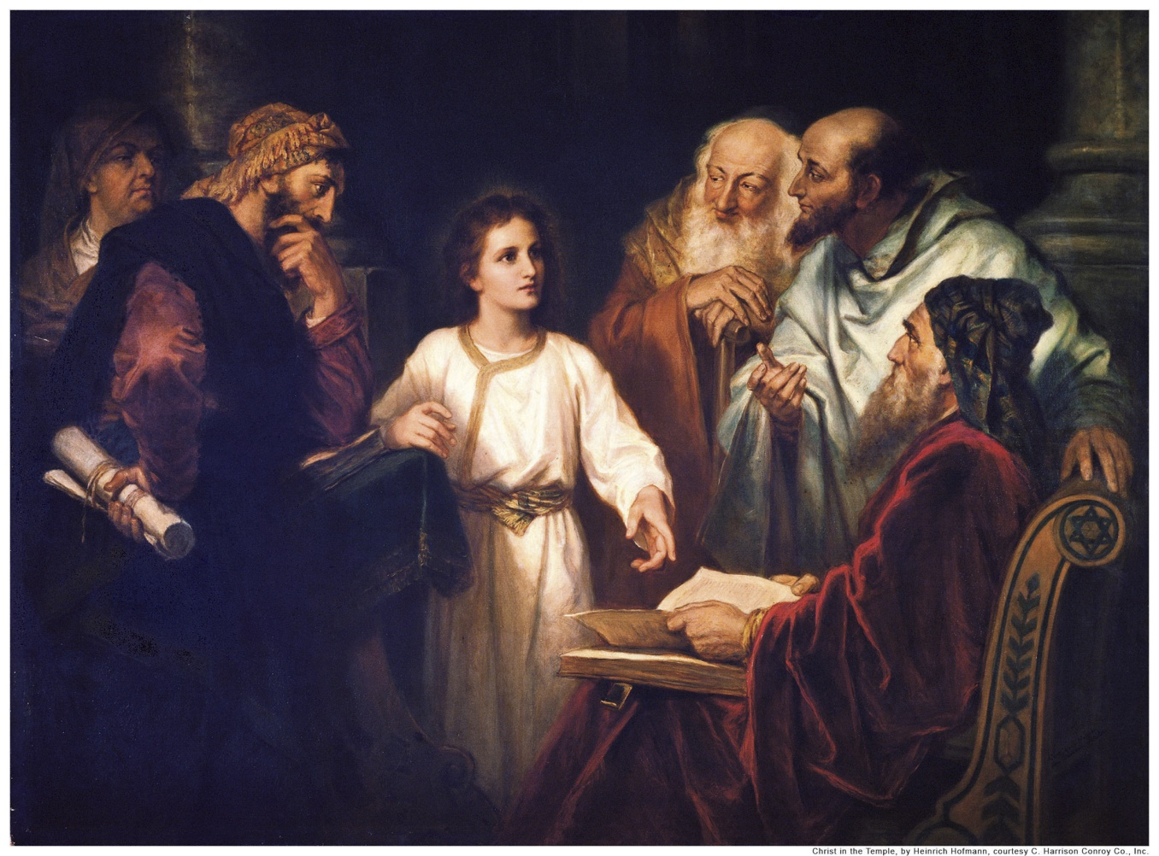
Luke 2:41-50
Jesus at the temple.

Slide 30
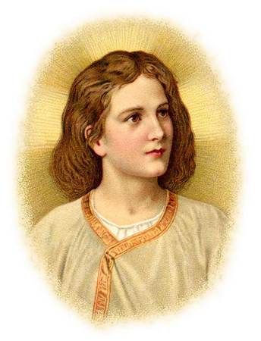
Luke 2:51-52
Young Jesus in Nazareth

Slide 31
The four Gospels converge with their accounts of the ministry of John:
Matthew 3:1 ¹ In those days came John the Baptist, preaching in the wilderness of Judaea,
Luke 3:1-2 ¹ Now in the fifteenth year of the reign of Tiberius Caesar, Pontius Pilate being governor of Judaea, and Herod being tetrarch of Galilee, and his brother Philip tetrarch of Ituraea and of the region of Trachonitis, and Lysanias the tetrarch of Abilene, ² Annas and Caiaphas being the high priests, the word of God came unto John the son of Zacharias in the wilderness.
Mark 1:1-2 ¹ The beginning of the gospel of Jesus Christ, the Son of God; ² As it is written in the prophets, Behold, I send my messenger before thy face, which shall prepare thy way before thee.
John 1:6 ⁶ There was a man sent from God, whose name was John.

