Slide 2
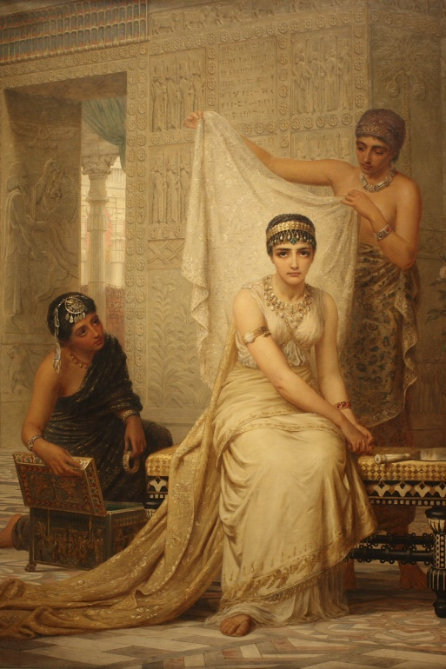
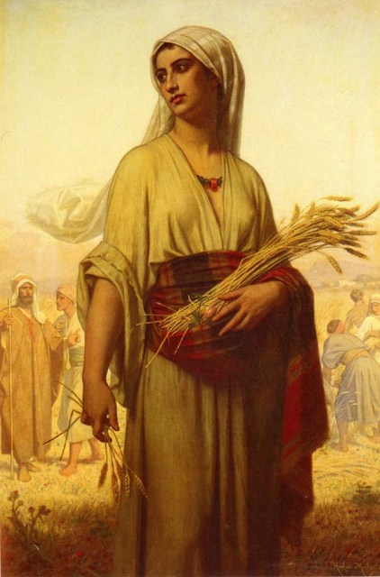
Points of Interest
In the Bible there are two books named for women: Esther and Ruth.
Esther, a Jew, marries a Gentile.
The name of God appears 0 times in the 167 verses of Esther.
Ruth, a Gentile, marries a Jew.
The name of God appears 23 times in the 85 verses of Ruth.
Esther was read at the Feast of Purim; Ruth was read at Pentecost.

Slide 3
The Kinsman Redeemer (Hebrew "go'el")
1) Had the right to buy back the property of a destitute relative in order to keep it within the tribe.
2) Had the right to redeem a relative from a life of servitude.
3) Had the right to be the avenger of blood.
4) Had the right of ‘Levirate marriage.’

Slide 4
The Kinsman Redeemer (Hebrew "go'el")
1) Had the right to buy back the property of a destitute relative in order to keep it within the tribe.
2) Had the right to redeem a relative from a life of servitude.
3) Had the right to be the avenger of blood.
4) Had the right of ‘Levirate marriage.’
Leviticus 25:25

Slide 5
The Kinsman Redeemer (Hebrew "go'el")
1) Had the right to buy back the property of a destitute relative in order to keep it within the tribe.
2) Had the right to redeem a relative from a life of servitude.
3) Had the right to be the avenger of blood.
4) Had the right of ‘Levirate marriage.’
Leviticus 25:25
If thy brother be waxen poor, and hath sold away some of his possession, and if any of his kin come to redeem it, then shall he redeem that which his brother sold.

Slide 6
The Kinsman Redeemer (Hebrew "go'el")
1) Had the right to buy back the property of a destitute relative in order to keep it within the tribe.
2) Had the right to redeem a relative from a life of servitude.
3) Had the right to be the avenger of blood.
4) Had the right of ‘Levirate marriage.’
Leviticus 25:47-49

Slide 7
The Kinsman Redeemer (Hebrew "go'el")
1) Had the right to buy back the property of a destitute relative in order to keep it within the tribe.
2) Had the right to redeem a relative from a life of servitude.
3) Had the right to be the avenger of blood.
4) Had the right of ‘Levirate marriage.’
Leviticus 25:47-49
And if a sojourner or stranger wax rich by thee, and thy brother that dwelleth by him wax poor, and sell himself unto the stranger or sojourner by thee, or to the stock of the stranger's family:
⁴⁸ After that he is sold he may be redeemed again; one of his brethren may redeem him:
⁴⁹ Either his uncle, or his uncle's son, may redeem him, or any that is nigh of kin unto him of his family may redeem him; or if he be able, he may redeem himself.

Slide 8
Deuteronomy 19:3-6 (the cities of refuge)
The Kinsman Redeemer (Hebrew "go'el")
1) Had the right to buy back the property of a destitute relative in order to keep it within the tribe.
2) Had the right to redeem a relative from a life of servitude.
3) Had the right to be the avenger of blood.
4) Had the right of ‘Levirate marriage.’

Slide 9
Deuteronomy 19:3-6 (the cities of refuge)
³ Thou shalt prepare thee a way, and divide the coasts of thy land, which the LORD thy God giveth thee to inherit, into three parts, that every slayer may flee thither.
⁴ And this is the case of the slayer, which shall flee thither, that he may live: Whoso killeth his neighbour ignorantly, whom he hated not in time past;
⁵ As when a man goeth into the wood with his neighbour to hew wood, and his hand fetcheth a stroke with the axe to cut down the tree, and the head slippeth from the helve, and lighteth upon his neighbour, that he die; he shall flee unto one of those cities, and live:
⁶ Lest the avenger of the blood pursue the slayer, while his heart is hot, and overtake him, because the way is long, and slay him; whereas he was not worthy of death, inasmuch as he hated him not in time past.
The Kinsman Redeemer (Hebrew "go'el")
1) Had the right to buy back the property of a destitute relative in order to keep it within the tribe.
2) Had the right to redeem a relative from a life of servitude.
3) Had the right to be the avenger of blood.
4) Had the right of ‘Levirate marriage.’

Slide 10
Deuteronomy 19:3-6 (the cities of refuge)
³ Thou shalt prepare thee a way, and divide the coasts of thy land, which the LORD thy God giveth thee to inherit, into three parts, that every slayer may flee thither.
⁴ And this is the case of the slayer, which shall flee thither, that he may live: Whoso killeth his neighbour ignorantly, whom he hated not in time past;
⁵ As when a man goeth into the wood with his neighbour to hew wood, and his hand fetcheth a stroke with the axe to cut down the tree, and the head slippeth from the helve, and lighteth upon his neighbour, that he die; he shall flee unto one of those cities, and live:
⁶ Lest the avenger of the blood pursue the slayer, while his heart is hot, and overtake him, because the way is long, and slay him; whereas he was not worthy of death, inasmuch as he hated him not in time past.
The Kinsman Redeemer (Hebrew "go'el")
1) Had the right to buy back the property of a destitute relative in order to keep it within the tribe.
2) Had the right to redeem a relative from a life of servitude.
3) Had the right to be the avenger of blood.
4) Had the right of ‘Levirate marriage.’

Slide 11
The Kinsman Redeemer (Hebrew "go'el")
1) Had the right to buy back the property of a destitute relative in order to keep it within the tribe.
2) Had the right to redeem a relative from a life of servitude.
3) Had the right to be the avenger of blood.
4) Had the right of ‘Levirate marriage.’
Latin levir means husband’s brother
Deuteronomy 25:5-6

Slide 12
The Kinsman Redeemer (Hebrew "go'el")
1) Had the right to buy back the property of a destitute relative in order to keep it within the tribe.
2) Had the right to redeem a relative from a life of servitude.
3) Had the right to be the avenger of blood.
4) Had the right of ‘Levirate marriage.’
Latin levir means husband’s brother
Deuteronomy 25:5-6
⁵ If brethren dwell together, and one of them die, and have no child, the wife of the dead shall not marry without unto a stranger: her husband's brother shall go in unto her, and take her to him to wife, and perform the duty of an husband's brother unto her.
⁶ And it shall be, that the firstborn which she beareth shall succeed in the name of his brother which is dead, that his name be not put out of Israel.

Slide 13
A brother’s refusal brought disgrace on his family.
Deuteronomy 25:7-10
The Kinsman Redeemer (Hebrew "go'el")
1) Had the right to buy back the property of a destitute relative in order to keep it within the tribe.
2) Had the right to redeem a relative from a life of servitude.
3) Had the right to be the avenger of blood.
4) Had the right of ‘Levirate marriage.’

Slide 14
A brother’s refusal brought disgrace on his family.
Deuteronomy 25:7-10
⁷ And if the man like not to take his brother's wife, then let his brother's wife go up to the gate unto the elders, and say, My husband's brother refuseth to raise up unto his brother a name in Israel, he will not perform the duty of my husband's brother.
⁸ Then the elders of his city shall call him, and speak unto him: and if he stand to it, and say, I like not to take her;
⁹ Then shall his brother's wife come unto him in the presence of the elders, and loose his shoe from off his foot, and spit in his face, and shall answer and say, So shall it be done unto that man that will not build up his brother's house.
¹⁰ And his name shall be called in Israel, The house of him that hath his shoe loosed.
The Kinsman Redeemer (Hebrew "go'el")
1) Had the right to buy back the property of a destitute relative in order to keep it within the tribe.
2) Had the right to redeem a relative from a life of servitude.
3) Had the right to be the avenger of blood.
4) Had the right of ‘Levirate marriage.’

Slide 15
The Kinsman Redeemer (Hebrew "go'el")
1) Had the right to buy back the property of a destitute relative in order to keep it within the tribe.
2) Had the right to redeem a relative from a life of servitude.
3) Had the right to be the avenger of blood.
4) Had the right of ‘Levirate marriage.’
In the case of Onan, refusal brought a severe penalty:
Genesis 38:6-10

Slide 16
The Kinsman Redeemer (Hebrew "go'el")
1) Had the right to buy back the property of a destitute relative in order to keep it within the tribe.
2) Had the right to redeem a relative from a life of servitude.
3) Had the right to be the avenger of blood.
4) Had the right of ‘Levirate marriage.’
In the case of Onan, refusal brought a severe penalty:
Genesis 38:6-10
⁶ And Judah took a wife for Er his firstborn, whose name was Tamar.
⁷ And Er, Judah's firstborn, was wicked in the sight of the LORD; and the LORD slew him.
⁸ And Judah said unto Onan, Go in unto thy brother's wife, and marry her, and raise up seed to thy brother.
⁹ And Onan knew that the seed should not be his; and it came to pass, when he went in unto his brother's wife, that he spilled it on the ground, lest that he should give seed to his brother.
¹⁰ And the thing which he did displeased the LORD: wherefore he slew him also.

Slide 17
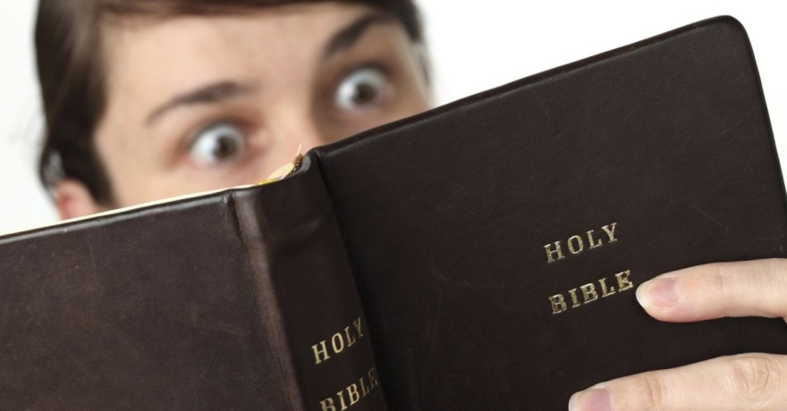

Slide 18
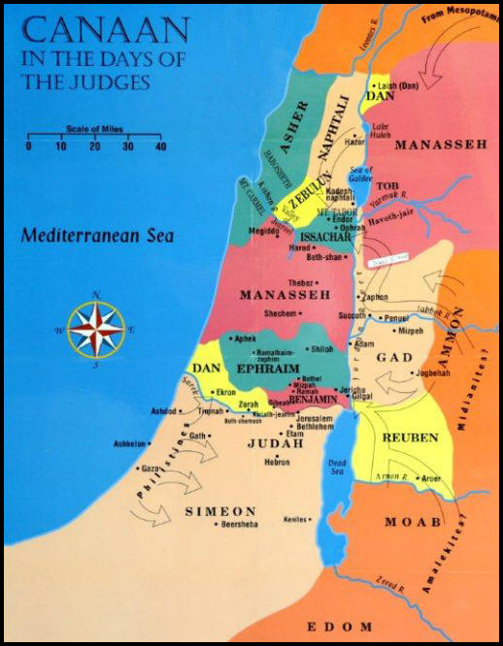
The Book of Ruth, Chapter 1

Slide 19
The Book of Ruth, Chapter 1
¹ Now it came to pass in the days when the judges ruled, that there was a famine in the land.
And a certain man of Bethlehemjudah went to sojourn in the country of Moab, he, and his wife, and his two sons.
² And the name of the man was Elimelech, and the name of his wife Naomi, and the name of his two sons Mahlon and Chilion, Ephrathites of Bethlehemjudah.
And they came into the country of Moab, and continued there.

Slide 20
They were “Ephrathites of Bethlehemjudah.”
Ephrath was the ancient name of Bethlehem.
Genesis 35:19: And Rachel died, and was buried in the way to Ephrath, which is Bethlehem.
Moab was a region east of the Dead Sea, in what is now the nation of Jordan.

Slide 21
The Book of Ruth, Chapter 1
¹ Now it came to pass in the days when the judges ruled, that there was a famine in the land.
Judges 6 testifies of such a famine:

Slide 22
Judges 6:1-6
¹ And the children of Israel did evil in the sight of the LORD: and the LORD delivered them into the hand of Midian seven years.
² And the hand of Midian prevailed against Israel: and because of the Midianites the children of Israel made them the dens which are in the mountains, and caves, and strong holds.
³ And so it was, when Israel had sown, that the Midianites came up, and the Amalekites, and the children of the east, even they came up against them;
⁴ And they encamped against them, and destroyed the increase of the earth, till thou come unto Gaza, and left no sustenance for Israel, neither sheep, nor ox, nor ass.
⁵ For they came up with their cattle and their tents, and they came as grasshoppers for multitude; for both they and their camels were without number: and they entered into the land to destroy it.
⁶ And Israel was greatly impoverished because of the Midianites; and the children of Israel cried unto the LORD.

Slide 23
The Book of Ruth, Chapter 1
¹ Now it came to pass in the days when the judges ruled, that there was a famine in the land.
And a certain man of Bethlehemjudah went to sojourn in the country of Moab, he, and his wife, and his two sons.
The Moabites were the descendants of Abraham’s nephew, Lot.
This tribe had a very disturbing beginning.
Genesis 19 records what happened soon after God destroyed Sodom and Gomorrah.

Slide 24
Genesis 19:30-38

Slide 25
Genesis 19:30-38
³⁰ And Lot went up out of Zoar, and dwelt in the mountain, and his two daughters with him; for he feared to dwell in Zoar: and he dwelt in a cave, he and his two daughters.
³¹ And the firstborn said unto the younger, Our father is old, and there is not a man in the earth to come in unto us after the manner of all the earth:
³² Come, let us make our father drink wine, and we will lie with him, that we may preserve seed of our father.
³³ And they made their father drink wine that night: and the firstborn went in, and lay with her father; and he perceived not when she lay down, nor when she arose.
³⁴ And it came to pass on the morrow, that the firstborn said unto the younger, Behold, I lay yesternight with my father: let us make him drink wine this night also; and go thou in, and lie with him, that we may preserve seed of our father.
³⁵ And they made their father drink wine that night also: and the younger arose, and lay with him; and he perceived not when she lay down, nor when she arose.
³⁶ Thus were both the daughters of Lot with child by their father.
³⁷ And the firstborn bare a son, and called his name Moab: the same is the father of the Moabites unto this day.
³⁸ And the younger, she also bare a son, and called his name Benammi: the same is the father of the children of Ammon unto this day.

Slide 26
The Book of Ruth, Chapter 1
¹ Now it came to pass in the days when the judges ruled, that there was a famine in the land.
And a certain man of Bethlehemjudah went to sojourn in the country of Moab, he, and his wife, and his two sons.
The Moabites were the descendants of Abraham’s nephew, Lot.
This tribe had a very disturbing beginning.
This incident occurred soon after God destroyed Sodom and Gomorrah.
The Law of Moses forbid the people of Moab and Ammon from entering the congregation of Israel.

Slide 27
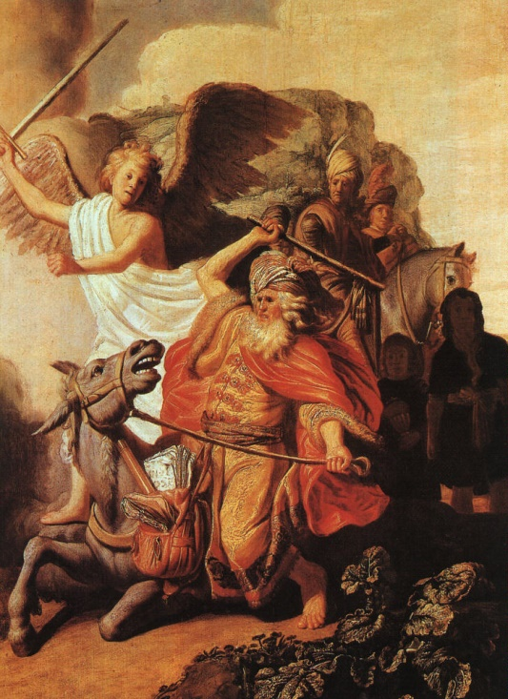
Deuteronomy 23:3-6

Slide 28
Deuteronomy 23:3-6
³ An Ammonite or Moabite shall not enter into the congregation of the LORD; even to their tenth generation shall they not enter into the congregation of the LORD for ever:
⁴ Because they met you not with bread and with water in the way, when ye came forth out of Egypt; and because they hired against thee Balaam the son of Beor of Pethor of Mesopotamia, to curse thee.
⁵ Nevertheless the LORD thy God would not hearken unto Balaam; but the LORD thy God turned the curse into a blessing unto thee, because the LORD thy God loved thee.
⁶ Thou shalt not seek their peace nor their prosperity all thy days for ever.

Slide 29
Elimelech and his sons:

Slide 30
Elimelech and his sons:
³ And Elimelech Naomi's husband died; and she was left, and her two sons.
⁴ And they took them wives of the women of Moab; the name of the one was Orpah, and the name of the other Ruth: and they dwelled there about ten years.
⁵ And Mahlon and Chilion died also both of them; and the woman was left of her two sons and her husband.

Slide 31
Elimelech and his sons:
³ And Elimelech Naomi's husband died; and she was left, and her two sons.
⁴ And they took them wives of the women of Moab; the name of the one was Orpah, and the name of the other Ruth: and they dwelled there about ten years.
⁵ And Mahlon and Chilion died also both of them; and the woman was left of her two sons and her husband.
Elimelech went out from under God’s canopy to fend for himself.
The family remained in Moab long past the end of the famine.
Elimelech died without an heir, and left his wife no sons to care for her.

Slide 32
Naomi’s return to Bethlehem:

Slide 33
Naomi’s return to Bethlehem:
⁶ Then she arose with her daughters in law, that she might return from the country of Moab: for she had heard in the country of Moab how that the LORD had visited his people in giving them bread.
⁷ Wherefore she went forth out of the place where she was, and her two daughters in law with her; and they went on the way to return unto the land of Judah.
⁸ And Naomi said unto her two daughters in law, Go, return each to her mother's house: the LORD deal kindly with you, as ye have dealt with the dead, and with me.
⁹ The LORD grant you that ye may find rest, each of you in the house of her husband. Then she kissed them; and they lifted up their voice, and wept.
¹⁰ And they said unto her, Surely we will return with thee unto thy people.

Slide 34
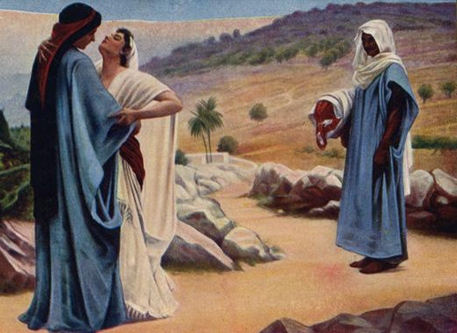
¹¹ And Naomi said, Turn again, my daughters: why will ye go with me? are there yet any more sons in my womb, that they may be your husbands?
¹² Turn again, my daughters, go your way; for I am too old to have an husband. If I should say, I have hope, if I should have an husband also to night, and should also bear sons;
¹³ Would ye tarry for them till they were grown? would ye stay for them from having husbands? nay, my daughters; for it grieveth me much for your sakes that the hand of the LORD is gone out against me.
¹⁴ And they lifted up their voice, and wept again: and Orpah kissed her mother in law; but Ruth clave unto her.

Slide 35
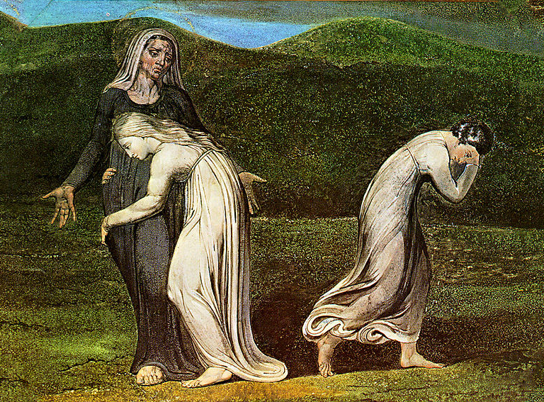
¹⁵ And she said, Behold, thy sister in law is gone back unto her people, and unto her gods: return thou after thy sister in law.
¹⁶ And Ruth said, Intreat me not to leave thee, or to return from following after thee: for whither thou goest, I will go; and where thou lodgest, I will lodge: thy people shall be my people, and thy God my God:
¹⁷ Where thou diest, will I die, and there will I be buried: the LORD do so to me, and more also, if ought but death part thee and me.
¹⁸ When she saw that she was stedfastly minded to go with her, then she left speaking unto her.

Slide 36
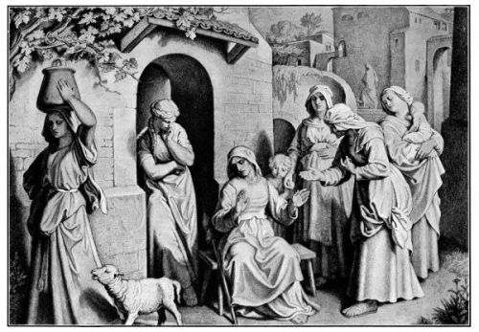
¹⁹ So they two went until they came to Bethlehem. And it came to pass, when they were come to Bethlehem, that all the city was moved about them, and they said, Is this Naomi?
²⁰ And she said unto them, Call me not Naomi, call me Mara: for the Almighty hath dealt very bitterly with me.
²¹ I went out full, and the LORD hath brought me home again empty: why then call ye me Naomi, seeing the LORD hath testified against me, and the Almighty hath afflicted me?
²² So Naomi returned, and Ruth the Moabitess, her daughter in law, with her, which returned out of the country of Moab: and they came to Bethlehem in the beginning of barley harvest.
²² So Naomi returned, and Ruth the Moabitess, her daughter in law, with her, which returned out of the country of Moab: and they came to Bethlehem in the beginning of barley harvest. (Pentecost)

Slide 37
¹⁹ So they two went until they came to Bethlehem. And it came to pass, when they were come to Bethlehem, that all the city was moved about them, and they said, Is this Naomi?
²⁰ And she said unto them, Call me not Naomi, call me Mara: for the Almighty hath dealt very bitterly with me.
²¹ I went out full, and the LORD hath brought me home again empty: why then call ye me Naomi, seeing the LORD hath testified against me, and the Almighty hath afflicted me?
²² So Naomi returned, and Ruth the Moabitess, her daughter in law, with her, which returned out of the country of Moab: and they came to Bethlehem in the beginning of barley harvest.
²² So Naomi returned, and Ruth the Moabitess, her daughter in law, with her, which returned out of the country of Moab: and they came to Bethlehem in the beginning of barley harvest. (Pentecost)
Naomi means Pleasant. Mara means Bitter.

Slide 38
¹⁹ So they two went until they came to Bethlehem. And it came to pass, when they were come to Bethlehem, that all the city was moved about them, and they said, Is this Naomi?
²⁰ And she said unto them, Call me not Naomi, call me Mara: for the Almighty hath dealt very bitterly with me.
²¹ I went out full, and the LORD hath brought me home again empty: why then call ye me Naomi, seeing the LORD hath testified against me, and the Almighty hath afflicted me?
²² So Naomi returned, and Ruth the Moabitess, her daughter in law, with her, which returned out of the country of Moab: and they came to Bethlehem in the beginning of barley harvest.
²² So Naomi returned, and Ruth the Moabitess, her daughter in law, with her, which returned out of the country of Moab: and they came to Bethlehem in the beginning of barley harvest. (Pentecost)
The barley season began at Pentecost.

Slide 39
Chapter 2

Slide 40
Chapter 2
¹ And Naomi had a kinsman of her husband's, a mighty man of wealth, of the family of Elimelech; and his name was Boaz.
² And Ruth the Moabitess said unto Naomi, Let me now go to the field, and glean ears of corn after him in whose sight I shall find grace. And she said unto her, Go, my daughter.

Slide 41
To glean is to gather what was left by the reapers.
Deuteronomy 24:19-22
Chapter 2
¹ And Naomi had a kinsman of her husband's, a mighty man of wealth, of the family of Elimelech; and his name was Boaz.
² And Ruth the Moabitess said unto Naomi, Let me now go to the field, and glean ears of corn after him in whose sight I shall find grace. And she said unto her, Go, my daughter.

Slide 42
To glean is to gather what is left by the reapers.
Deuteronomy 24:19-22
¹⁹ When thou cuttest down thine harvest in thy field, and hast forgot a sheaf in the field, thou shalt not go again to fetch it: it shall be for the stranger, for the fatherless, and for the widow: that the LORD thy God may bless thee in all the work of thine hands.
²⁰ When thou beatest thine olive tree, thou shalt not go over the boughs again: it shall be for the stranger, for the fatherless, and for the widow.
²¹ When thou gatherest the grapes of thy vineyard, thou shalt not glean it afterward: it shall be for the stranger, for the fatherless, and for the widow.
²² And thou shalt remember that thou wast a bondman in the land of Egypt: therefore I command thee to do this thing.
Chapter 2
¹ And Naomi had a kinsman of her husband's, a mighty man of wealth, of the family of Elimelech; and his name was Boaz.
² And Ruth the Moabitess said unto Naomi, Let me now go to the field, and glean ears of corn after him in whose sight I shall find grace. And she said unto her, Go, my daughter.

Slide 43
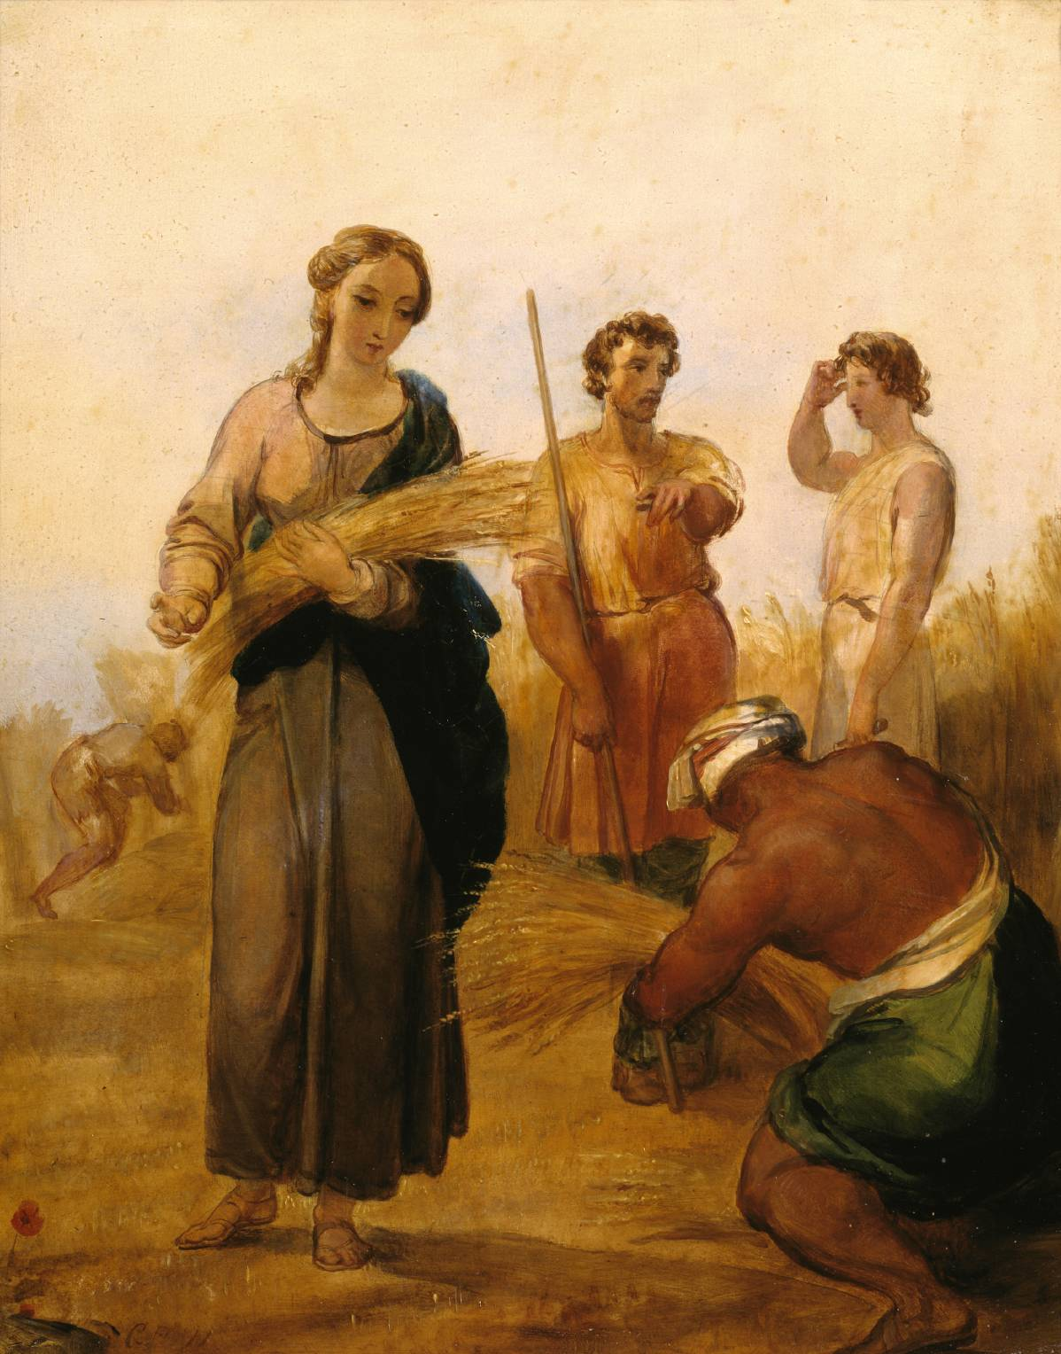
³ And she went, and came, and gleaned in the field after the reapers: and her hap was to light on a part of the field belonging unto Boaz, who was of the kindred of Elimelech.
⁴ And, behold, Boaz came from Bethlehem, and said unto the reapers, The LORD be with you. And they answered him, The LORD bless thee.
⁵ Then said Boaz unto his servant that was set over the reapers, Whose damsel is this?
⁶ And the servant that was set over the reapers answered and said, It is the Moabitish damsel that came back with Naomi out of the country of Moab:

Slide 44
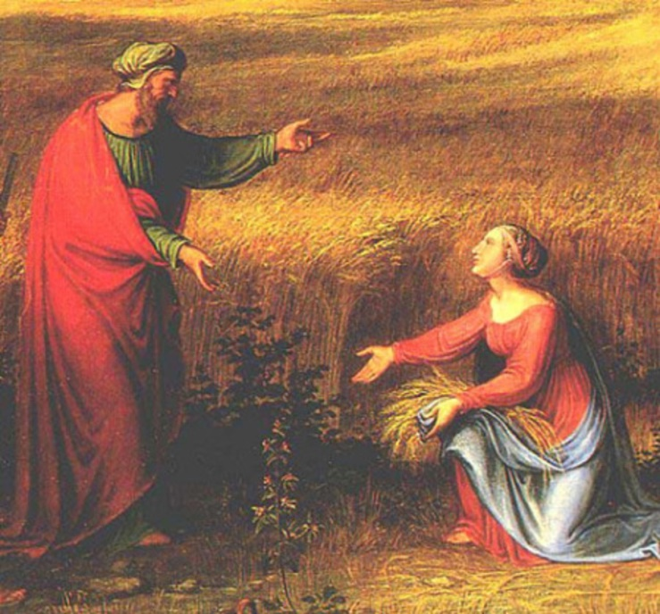
⁷ And she said, I pray you, let me glean and gather after the reapers among the sheaves: so she came, and hath continued even from the morning until now, that she tarried a little in the house.
⁸ Then said Boaz unto Ruth, Hearest thou not, my daughter? Go not to glean in another field, neither go from hence, but abide here fast by my maidens:
⁹ Let thine eyes be on the field that they do reap, and go thou after them: have I not charged the young men that they shall not touch thee? and when thou art athirst, go unto the vessels, and drink of that which the young men have drawn.

Slide 45
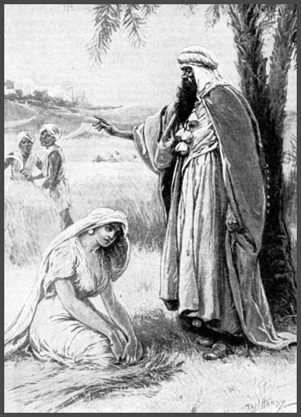
¹⁰ Then she fell on her face, and bowed herself to the ground, and said unto him, Why have I found grace in thine eyes, that thou shouldest take knowledge of me, seeing I am a stranger?
¹¹ And Boaz answered and said unto her, It hath fully been shewed me, all that thou hast done unto thy mother in law since the death of thine husband: and how thou hast left thy father and thy mother, and the land of thy nativity, and art come unto a people which thou knewest not heretofore.
¹² The LORD recompense thy work, and a full reward be given thee of the LORD God of Israel, under whose wings thou art come to trust.

Slide 46
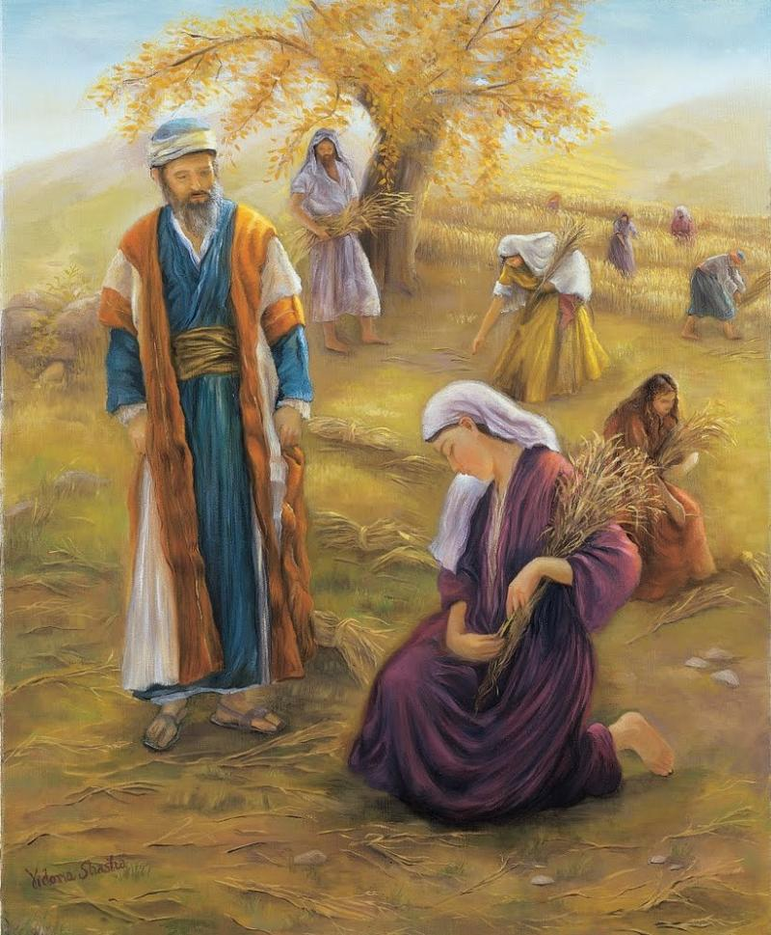
¹³ Then she said, Let me find favour in thy sight, my lord; for that thou hast comforted me, and for that thou hast spoken friendly unto thine handmaid, though I be not like unto one of thine handmaidens.
¹⁴ And Boaz said unto her, At mealtime come thou hither, and eat of the bread, and dip thy morsel in the vinegar.
And she sat beside the reapers: and he reached her parched corn, and she did eat, and was sufficed, and left.

Slide 47
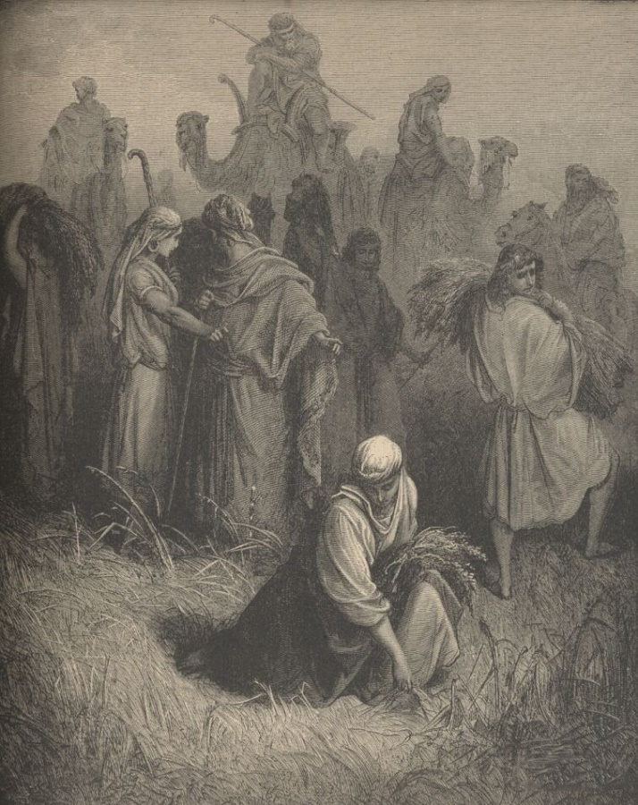
¹⁵ And when she was risen up to glean, Boaz commanded his young men, saying, Let her glean even among the sheaves, and reproach her not:
¹⁶ And let fall also some of the handfuls of purpose for her, and leave them, that she may glean them, and rebuke her not.
¹⁷ So she gleaned in the field until even, and beat out that she had gleaned: and it was about an ephah of barley.

Slide 48
¹⁵ And when she was risen up to glean, Boaz commanded his young men, saying, Let her glean even among the sheaves, and reproach her not:
¹⁶ And let fall also some of the handfuls of purpose for her, and leave them, that she may glean them, and rebuke her not.
¹⁷ So she gleaned in the field until even, and beat out that she had gleaned: and it was about an ephah of barley.
An ephah is about a bushel. A bushel of barley weighs about 48 pounds.

Slide 49
¹⁸ And she took it up, and went into the city: and her mother in law saw what she had gleaned: and she brought forth, and gave to her that she had reserved after she was sufficed.
¹⁹ And her mother in law said unto her, Where hast thou gleaned to day? and where wroughtest thou? blessed be he that did take knowledge of thee. And she shewed her mother in law with whom she had wrought, and said, The man's name with whom I wrought to day is Boaz.
²⁰ And Naomi said unto her daughter in law, Blessed be he of the LORD, who hath not left off his kindness to the living and to the dead. And Naomi said unto her, The man is near of kin unto us, one of our next kinsmen.
²¹ And Ruth the Moabitess said, He said unto me also, Thou shalt keep fast by my young men, until they have ended all my harvest.
²² And Naomi said unto Ruth her daughter in law, It is good, my daughter, that thou go out with his maidens, that they meet thee not in any other field.
²³ So she kept fast by the maidens of Boaz to glean unto the end of barley harvest and of wheat harvest; and dwelt with her mother in law.

Slide 50
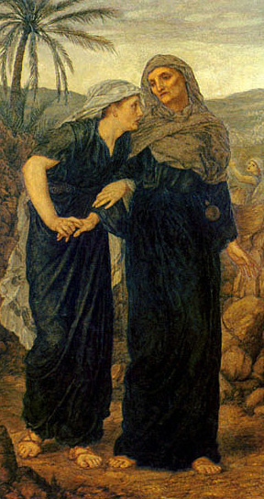
Chapter 3:

Slide 51
Chapter 3:
¹ Then Naomi her mother in law said unto her, My daughter, shall I not seek rest for thee, that it may be well with thee?
² And now is not Boaz of our kindred, with whose maidens thou wast? Behold, he winnoweth barley to night in the threshingfloor.
³ Wash thyself therefore, and anoint thee, and put thy raiment upon thee, and get thee down to the floor: but make not thyself known unto the man, until he shall have done eating and drinking.
⁴ And it shall be, when he lieth down, that thou shalt mark the place where he shall lie, and thou shalt go in, and uncover his feet, and lay thee down; and he will tell thee what thou shalt do.
⁵ And she said unto her, All that thou sayest unto me I will do.

Slide 52
Chapter 3:
¹ Then Naomi her mother in law said unto her, My daughter, shall I not seek rest for thee, that it may be well with thee?
² And now is not Boaz of our kindred, with whose maidens thou wast? Behold, he winnoweth barley to night in the threshingfloor.
To winnow is to blow a current of air through grain in order to remove the chaff.
Because he was a close relative, Naomi knew that Boaz was a potential husband for Ruth.

Slide 53
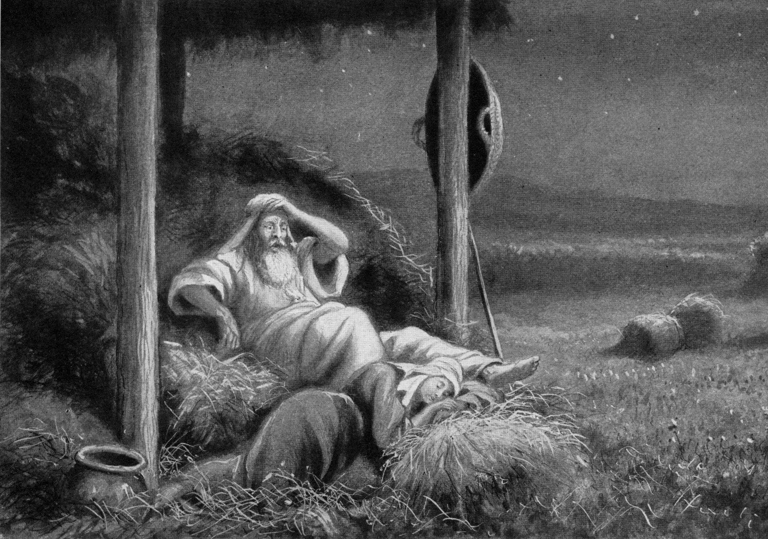
⁶ And she went down unto the floor, and did according to all that her mother in law bade her.
⁷ And when Boaz had eaten and drunk, and his heart was merry, he went to lie down at the end of the heap of corn: and she came softly, and uncovered his feet, and laid her down.
⁸ And it came to pass at midnight, that the man was afraid, and turned himself: and, behold, a woman lay at his feet.

Slide 54
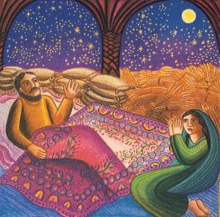
⁹ And he said, Who art thou? And she answered, I am Ruth thine handmaid: spread therefore thy skirt over thine handmaid; for thou art a near kinsman.
¹⁰ And he said, Blessed be thou of the LORD, my daughter: for thou hast shewed more kindness in the latter end than at the beginning, inasmuch as thou followedst not young men, whether poor or rich.
¹¹ And now, my daughter, fear not; I will do to thee all that thou requirest: for all the city of my people doth know that thou art a virtuous woman.

Slide 55
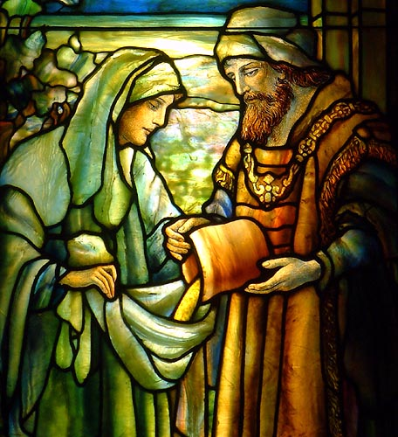
¹² And now it is true that I am thy near kinsman: howbeit there is a kinsman nearer than I.
¹³ Tarry this night, and it shall be in the morning, that if he will perform unto thee the part of a kinsman, well; let him do the kinsman's part: but if he will not do the part of a kinsman to thee, then will I do the part of a kinsman to thee, as the LORD liveth: lie down until the morning.
¹⁴ And she lay at his feet until the morning: and she rose up before one could know another. And he said, Let it not be known that a woman came into the floor.
¹⁵ Also he said, Bring the vail that thou hast upon thee, and hold it. And when she held it, he measured six measures of barley, and laid it on her: and she went into the city.

Slide 56
¹⁶ And when she came to her mother in law, she said, Who art thou, my daughter? And she told her all that the man had done to her.
¹⁷ And she said, These six measures of barley gave he me; for he said to me, Go not empty unto thy mother in law.
¹⁸ Then said she, Sit still, my daughter, until thou know how the matter will fall: for the man will not be in rest, until he have finished the thing this day.

Slide 57
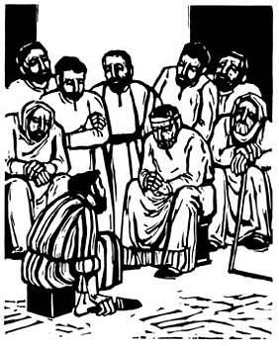
Chapter 4

Slide 58
Chapter 4
¹ Then went Boaz up to the gate, and sat him down there: and, behold, the kinsman of whom Boaz spake came by; unto whom he said, Ho, such a one! turn aside, sit down here. And he turned aside, and sat down.
² And he took ten men of the elders of the city, and said, Sit ye down here. And they sat down.
³ And he said unto the kinsman, Naomi, that is come again out of the country of Moab, selleth a parcel of land, which was our brother Elimelech's:
⁴ And I thought to advertise thee, saying, Buy it before the inhabitants, and before the elders of my people. If thou wilt redeem it, redeem it: but if thou wilt not redeem it, then tell me, that I may know: for there is none to redeem it beside thee; and I am after thee. And he said, I will redeem it.

Slide 59
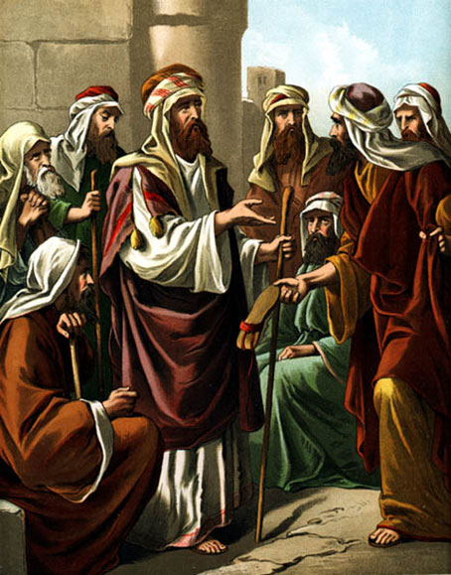
⁵ Then said Boaz, What day thou buyest the field of the hand of Naomi, thou must buy it also of Ruth the Moabitess, the wife of the dead, to raise up the name of the dead upon his inheritance.
⁶ And the kinsman said, I cannot redeem it for myself, lest I mar mine own inheritance: redeem thou my right to thyself; for I cannot redeem it.
⁷ Now this was the manner in former time in Israel concerning redeeming and concerning changing, for to confirm all things; a man plucked off his shoe, and gave it to his neighbour: and this was a testimony in Israel.
⁸ Therefore the kinsman said unto Boaz, Buy it for thee. So he drew off his shoe.

Slide 60
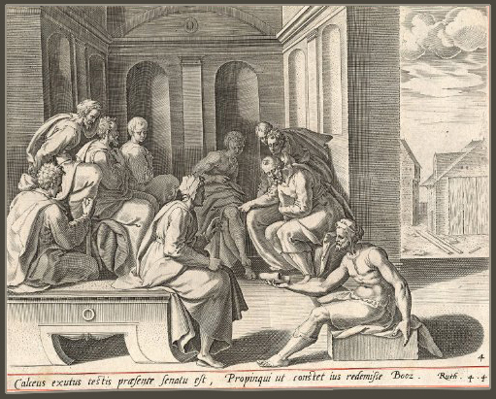
⁹ And Boaz said unto the elders, and unto all the people, Ye are witnesses this day, that I have bought all that was Elimelech's, and all that was Chilion's and Mahlon's, of the hand of Naomi.
¹⁰ Moreover Ruth the Moabitess, the wife of Mahlon, have I purchased to be my wife, to raise up the name of the dead upon his inheritance, that the name of the dead be not cut off from among his brethren, and from the gate of his place: ye are witnesses this day.

Slide 61
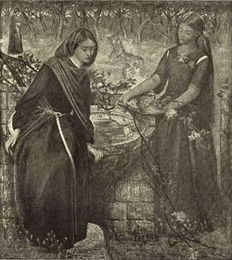
¹¹ And all the people that were in the gate, and the elders, said, We are witnesses. The LORD make the woman that is come into thine house like Rachel and like Leah, which two did build the house of Israel: and do thou worthily in Ephratah, and be famous in Bethlehem:
¹² And let thy house be like the house of Pharez, whom Tamar bare unto Judah, of the seed which the LORD shall give thee of this young woman.

Slide 62
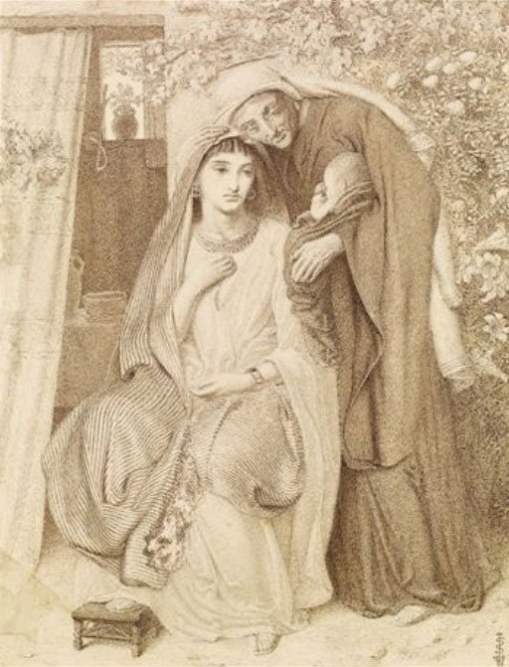
¹³ So Boaz took Ruth, and she was his wife: and when he went in unto her, the LORD gave her conception, and she bare a son.
¹⁴ And the women said unto Naomi, Blessed be the LORD, which hath not left thee this day without a kinsman, that his name may be famous in Israel.
¹⁵ And he shall be unto thee a restorer of thy life, and a nourisher of thine old age: for thy daughter in law, which loveth thee, which is better to thee than seven sons, hath born him.

Slide 63
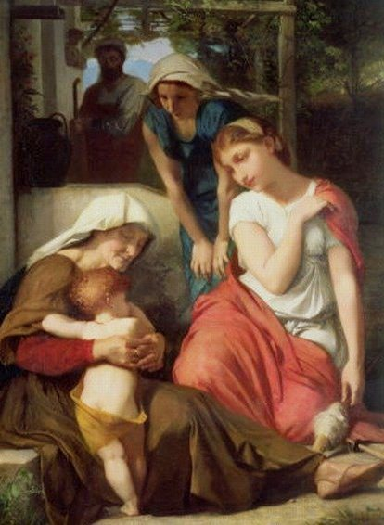
¹⁶ And Naomi took the child, and laid it in her bosom, and became nurse unto it.
¹⁷ And the women her neighbours gave it a name, saying, There is a son born to Naomi; and they called his name Obed:
he is the father of Jesse, the father of David.

Slide 64
¹⁸ Now these are the generations of Pharez:
Pharez begat Hezron,
¹⁹ And Hezron begat Ram, and Ram begat Amminadab,
²⁰ And Amminadab begat Nahshon, and Nahshon begat Salmon,
²¹ And Salmon begat Boaz, and Boaz begat Obed,
²² And Obed begat Jesse, and Jesse begat David.

Slide 65
The Allegory of Ruth:
John 1:17
For the law was given by Moses, but grace and truth came by Jesus Christ.
The “nearer kinsman” represented the Law of Moses, which could not redeem Naomi (Israel) and could not and would not redeem Ruth (a Gentile).
Boaz is a type of God’s grace in the person of Jesus Christ.

